Slide 1
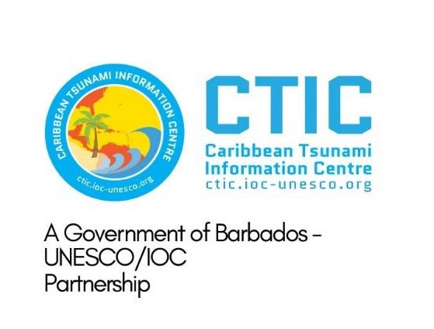





ICG/CARIBE-EWS XIX
CARIBE WAVE 2026
Summary
Gisela Báez-Sánchez
CARIBE WAVE Chair, Puerto Rico Seismic Network, USA
Antonio Aguilar
CARIBE WAVE Vice Chair, FUNVISIS, Venezuela
Supported by:
Christa G. von Hillebrandt-Andrade
Manager, ITIC Caribbean Office
ICG CARIBE EWS WG III Chair
Kimberly Maisonet Gonzalez
Student Contractor
ITIC Caribbean Office
April 23, 2026

Slide 2
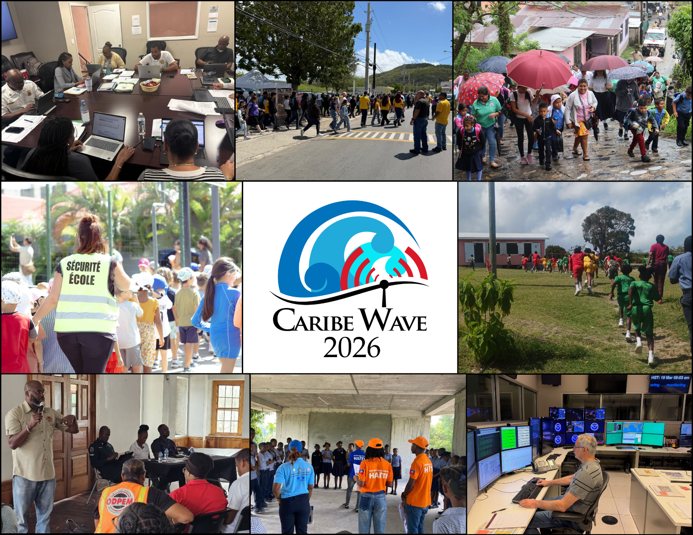
CARIBE WAVE 2026
CARIBE WAVE 26 was held on March 19, 2026.
Member States and Territories chose from the two scenarios (Cayman Islands and Kick ‘em Jenny) and decided if any additional activity would be carried out.
In the Caribbean and Adjacent Regions, 45 Member States and Territories participated with a total of over 619,340 people engaged (94% participation of MS and territories).
b
CARIBE WAVE 26 Exercise Photos. From Left to Right: Emergency Operations Center, St. Croix, U.S. Virgin Islands; Áurea E. Quiles Claudio High School in Guánica, Puerto Rico; Omoa Community Exercise, Honduras; Evacuation of the Gustavia School Complex, Saint Barthélemy; New Winthorpes Primary School, St. John, Antigua & Barbuda, ODPEM activity, Jamaica; Les Cayes Schools with UNESCO and Civil Protection, Haiti; and the Pacific Tsunami Warning Center in Honolulu, Hawaii.
a
#CARIBEWAVE #TSUNAMIREADY

Slide 3
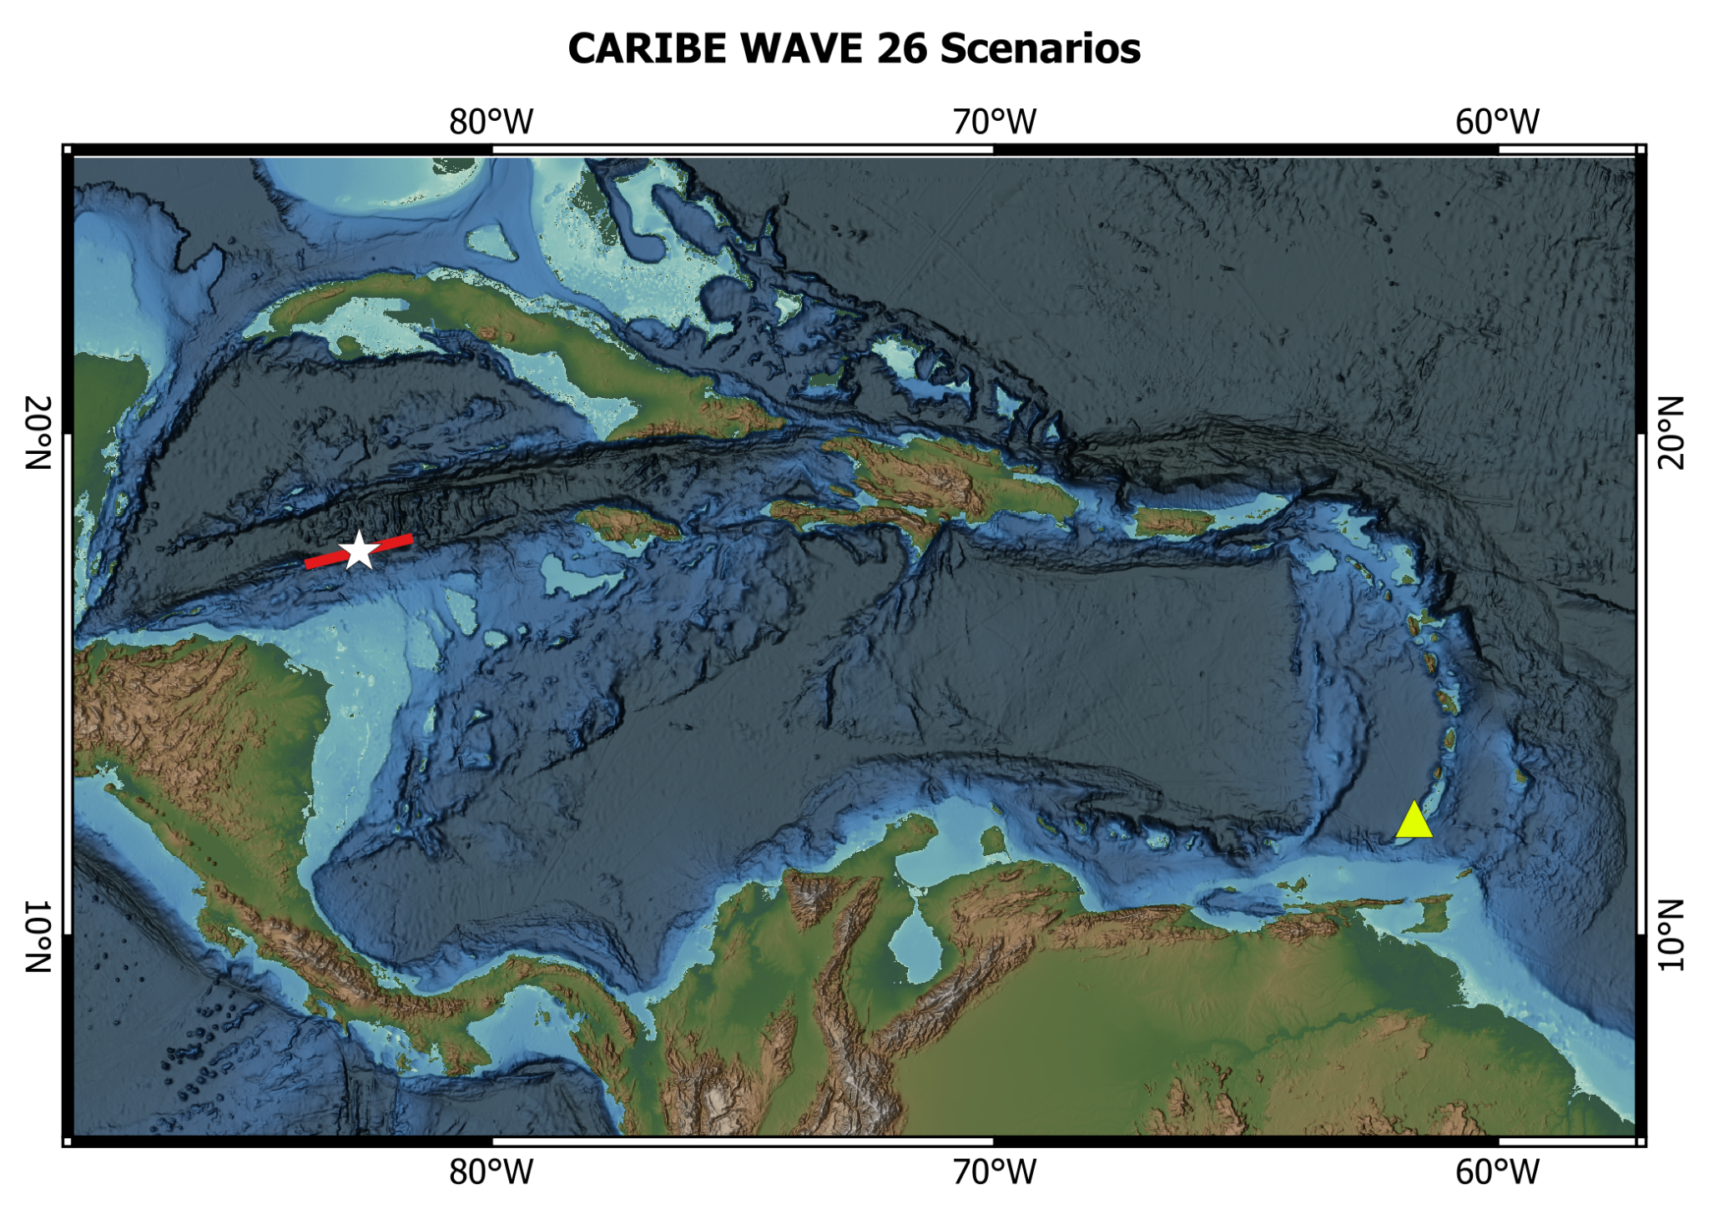
CARIBE WAVE 26
Tsunami Scenarios
Cayman Islands
Kick ‘em Jenny
Scenario | Origin Time | Mw | Epicenter
Cayman Islands | 15:00:00 UTC 19 March 2026 | 7.6 | 17.646ºN, 82.6285ºW
Kick ‘em Jenny |  | - | 12.3ºN, 61.63ºW

Slide 4
Timeline
ACTION | Target and delivery dates
Handbook Draft Circulated among ICG CARIBE-EWS CARIBE WAVE 26 Task Team | October 2025
Deadline for Comments | November 2025
Circular Letter Issued by IOC to MS | Target: December 2025 | Delivery: January 2026
Exercise Handbook Available Online | Target: December 2025 | Delivery: January 2026
First Webinar CW | 20 January 2026 – English 21 January 2026 – Spanish 22 January 2026 – French
Second Webinar CW | 24 February 2026 – English 25 February 2026 – Spanish 26 February 2026 – French
Countries Indicate Selected Scenario | 6 March 2026
Exercise | 19 March 2026
Hot-Wash | 26 March 2026
Exercise Evaluation Due | Target: 3 April 2026 | Delivery: 13 April 2026
Draft CARIBE WAVE 26 Report | 17 April 2026
Notes:
Need to emphasize that there was a delay in getting out CL and Handbook, due to delays in defining sources and generating products (KemJ).
Enfatizar que contesten los formularios de evaluación en la fecha indicada.

Slide 5
Goals / Metrics
Goals | 2016 Results | 2017 Results | 2018 Results | 2019 Results | 2020 Results | 2021 Results | 2022 Results | 2023 Results | 2024 Results | 2025 Results | 2026 Metrics | 2026 Results
TWFP receive the dummy message | 84% | 95% | 100% | 89% | 97% | 97% | 91% | 97% | 100% | 100% | 100% | 94%
Participation of Member States of the ICG/CARIBE-EWS with designated focal warning point | 100% | 100% | 97% | 100% | 92% | 98% | 100% | 94% | 96% | 93% | 100% | 94%
Community involvement (including agencies beyond TWFP) | 73% | 82% | 77% | 66% | 38% | 56% | 43% | 41% | 76% | 81% | 95% | 87%
Number of participants* | 332,812 | 679,985 | 643,403 | 793,353 | 4,622 | 333,518 | 413,281 | 422,913 | 470,423 | 510,360 | +10% | 619,340
Countries who participate submit exercise questionnaire | 100% | 100% | 91% | 82% | 92% | 95% | 100% | 93% | 80% | 91% | 100% | 91%
Members State and Territories are satisfied with exercise |  |  |  | 82% | 76% | 96% | 88% | 97% | 100% | 86% | 100% | 96%
*As reported by Member States and Territories in survey

Slide 6
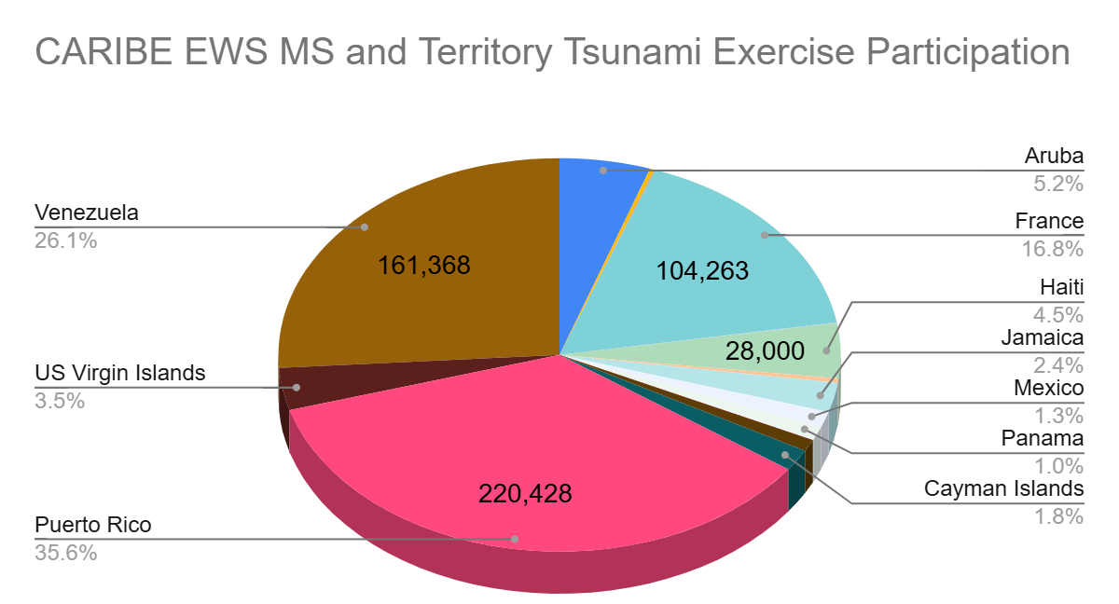
619,340 Total Participants According to MS

Slide 7
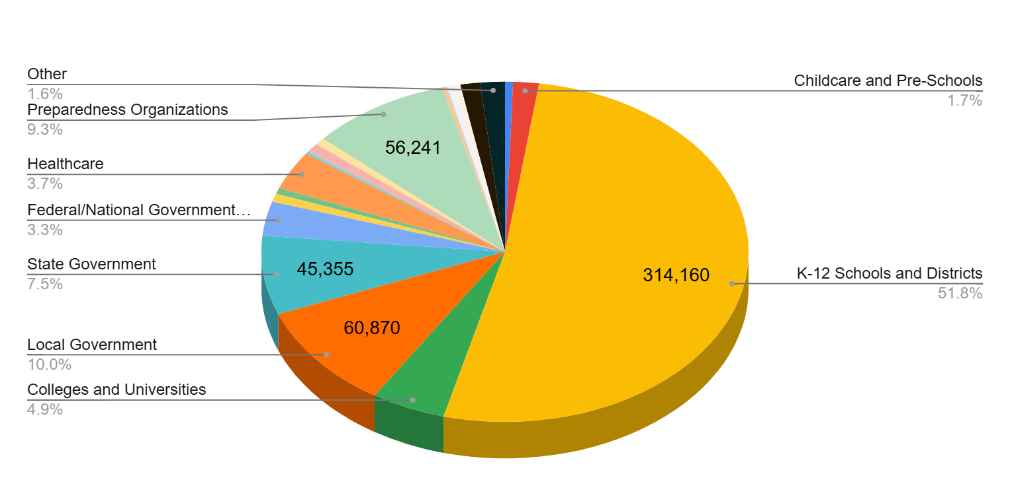
606,265 Registered Participants from all Categories on TsunamiZone.org

Slide 8
Hot-Wash
After the exercise, the CARIBE WAVE 26 Task Team organized a post-exercise “hot-wash” webinar to permit Member States and Territories to discuss and provide feedback on the exercise in an open forum on March 26, 2026.
Some of the feedback was on the successful completion of the exercise.
It was stated that the Kick ‘em Jenny scenario was helpful for identifying gaps for volcanic events.
Some expressed dissatisfaction with the low-impact scenarios, opting for a greater challenge in the future.
Regarding improvements for future exercises, there are plans for enhancing the CARIBE WAVE webpage (caribewave.org). The importance of multiple, redundant, and reliable methods of communication beyond email was reiterated.

Slide 9
Evaluation Form
The questionnaire contained 50 questions for participating countries to provide feedback on the exercise.
Original deadline was Deadline was April 3, then extended until April 13.
Responses from 91% (41/45) of participating MS and territories (32 surveys total).

Slide 10
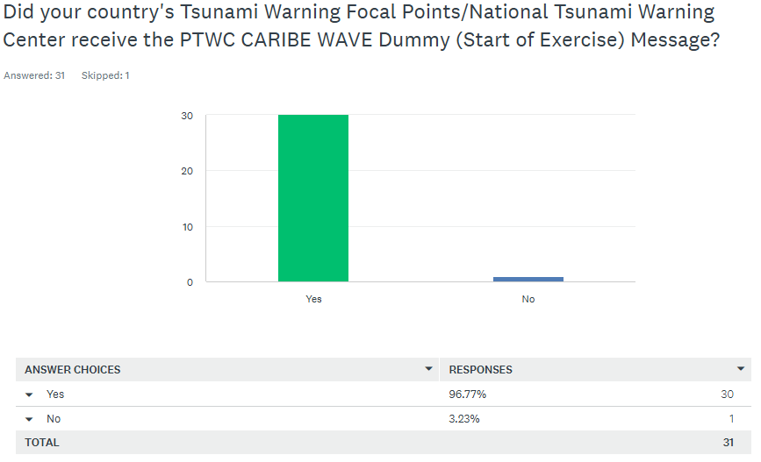
The PTWC issued the “dummy” message on March 19, 2026 at 1500 UTC

Slide 11
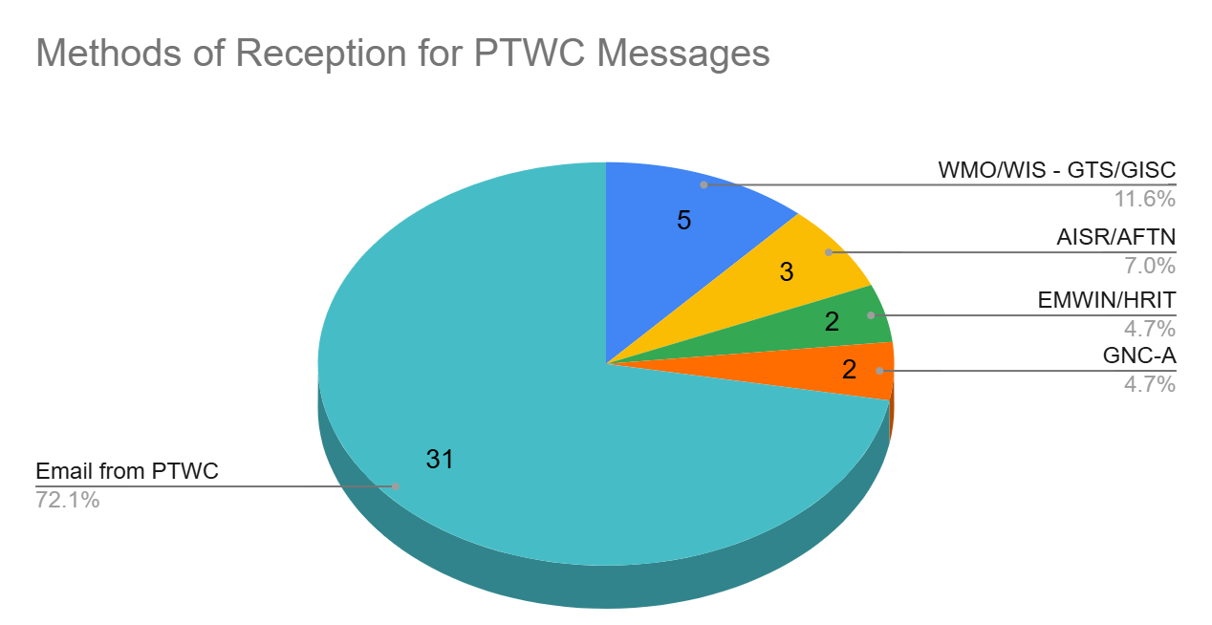
As in past years, the most common method to receive the Dummy message was Email

Slide 12
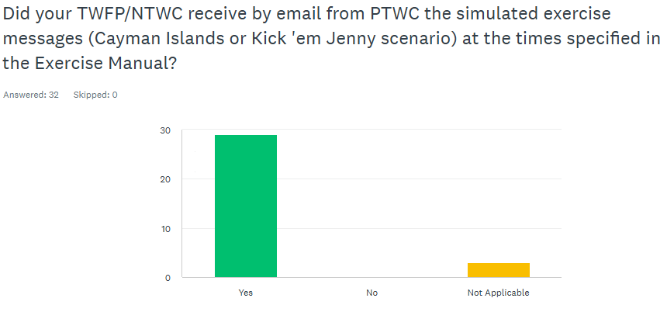
The majority stated that they received the dummy message at 1500 UTC
It is crucial to seek other communication systems to avoid messages delays.
The message was received by most countries within the first 1-5 minutes.

Slide 13
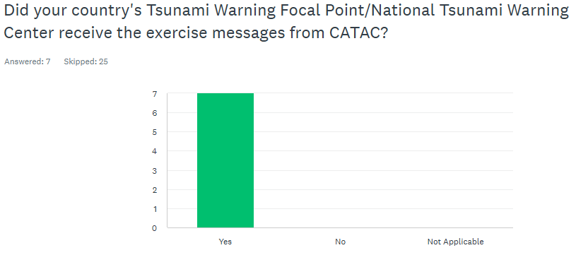
All Central-American MS received the messages from CATAC with some reported issues

Slide 14
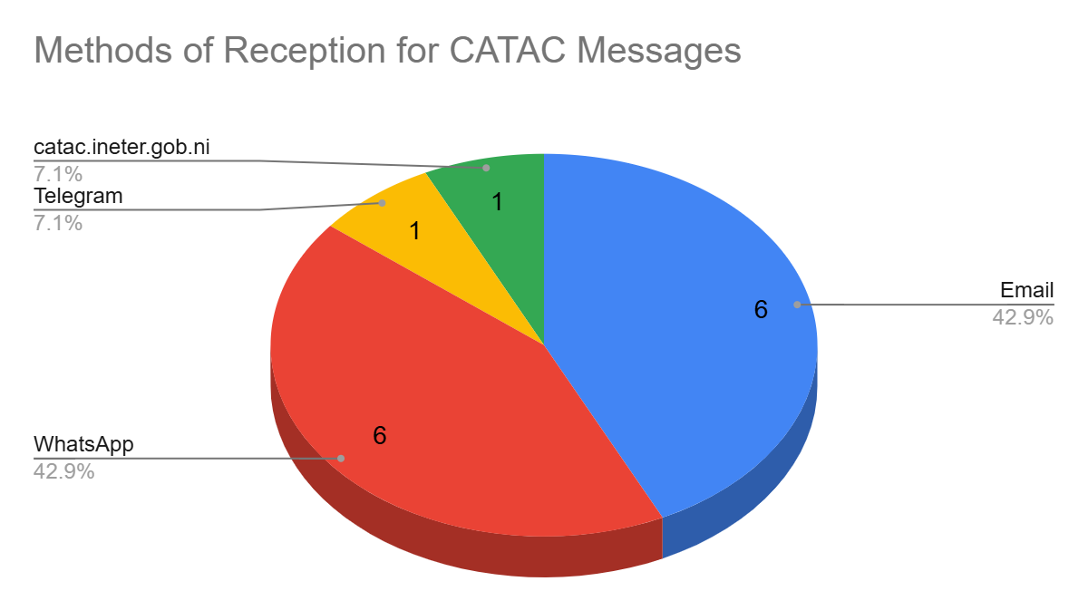
The principal methods of reception were email and WhatsApp

Slide 15
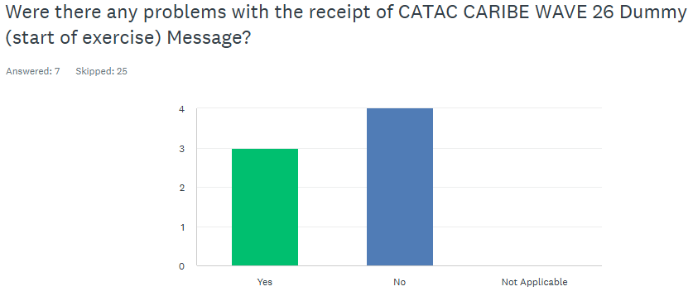
Some reported issues with the CATAC messages
Mexico: WE ONLY RECEIVED THE DUMMY MESSAGE
Honduras: I didn't get many emails, and I didn't get any messages on Telegram
Panama: All the messages (Dummy - Message 5) were receive complete by WhatsApp. Incomplete by Email
Costarica: We only received one email corresponding to message #5 at 17:49

Slide 16
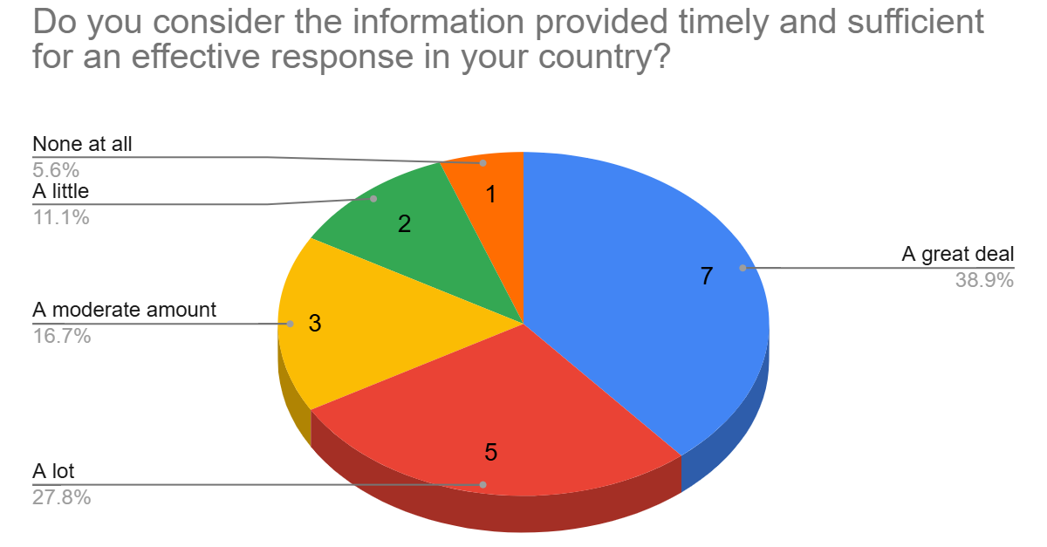
Most countries considered the information in the volcanic scenario products timely and sufficient for effective response
NL- Bonaire, Saba, Sint Eustatius: Upon receipt of the third message sequence number, wave arrival was already imminent for our areas, leaving little time for preparation. Improved forecasting or rough estimations of arrival times would enable more timely responses.
UK- British Virgin Islands: It gave us a few hours lead

Slide 17
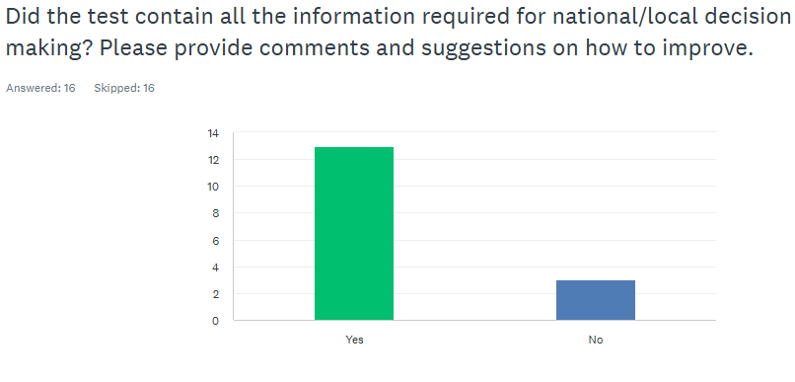
Threat Messages
Guyana: Unfortunately , Guyana was not mentioned in any of the messages.
NL- Bonaire, Saba, Sint Eustatius: The stakeholders could be warned of incoming waves well on time. However, in this scenario, accurate arrival times could not be forecast. Providing a rough range of estimated arrival times based on typical or modelled tsunami wave speeds could still have helped stakeholders anticipate when waves might occur.
UK Anguilla: Anguilla was not listed at first, which prompted us to do some calculations using the TTTC. That also was an interesting experience. The team is new, and we need some more training on those tools.
France: For Martinique, our closest territory, it was OK, but for Guadeloupe, it is the contrary: Some confusion arose because this territory was not present in the initial list of potentially impacted territories, but was impacted later.

Slide 18
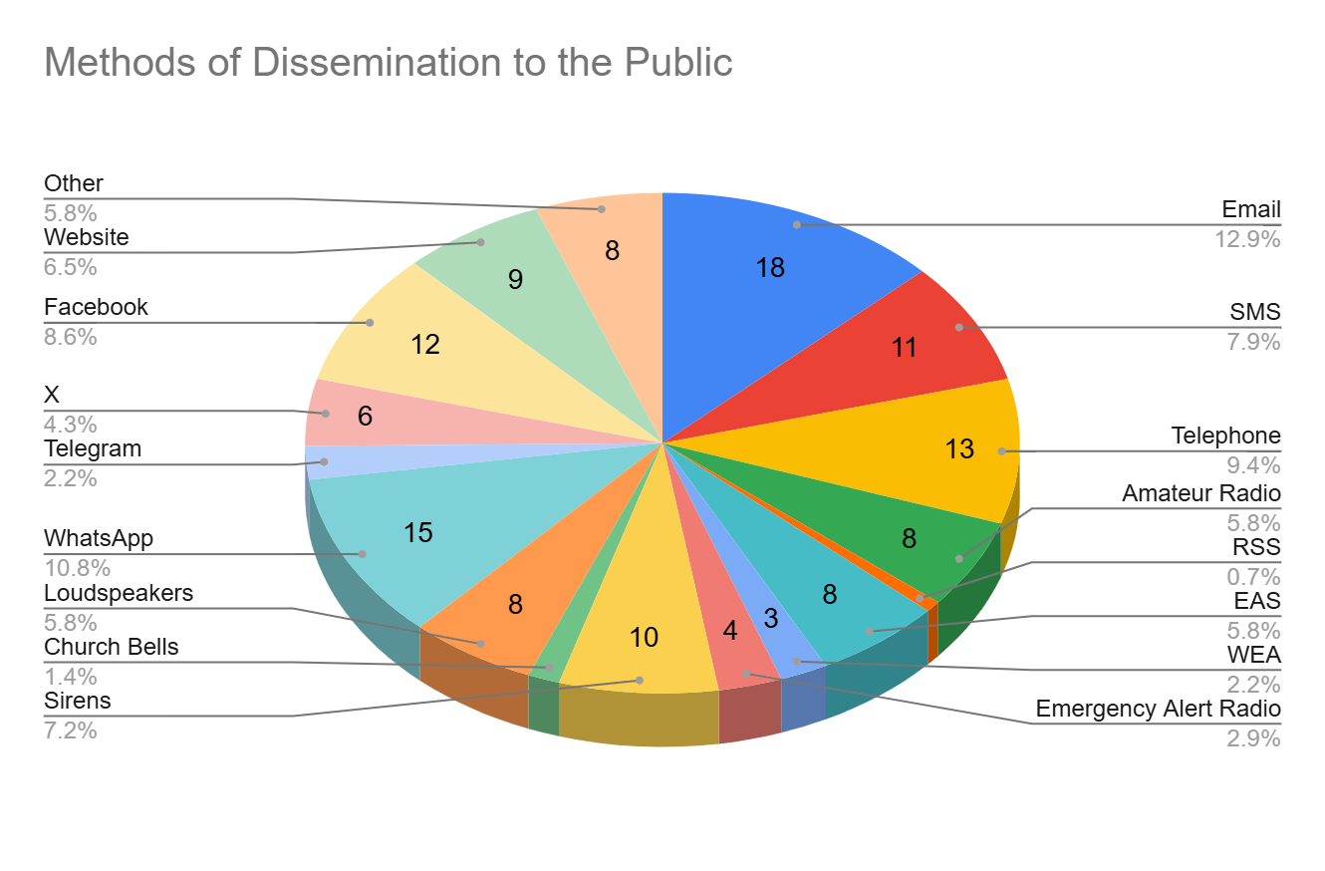
Methods of Dissemination

Slide 19
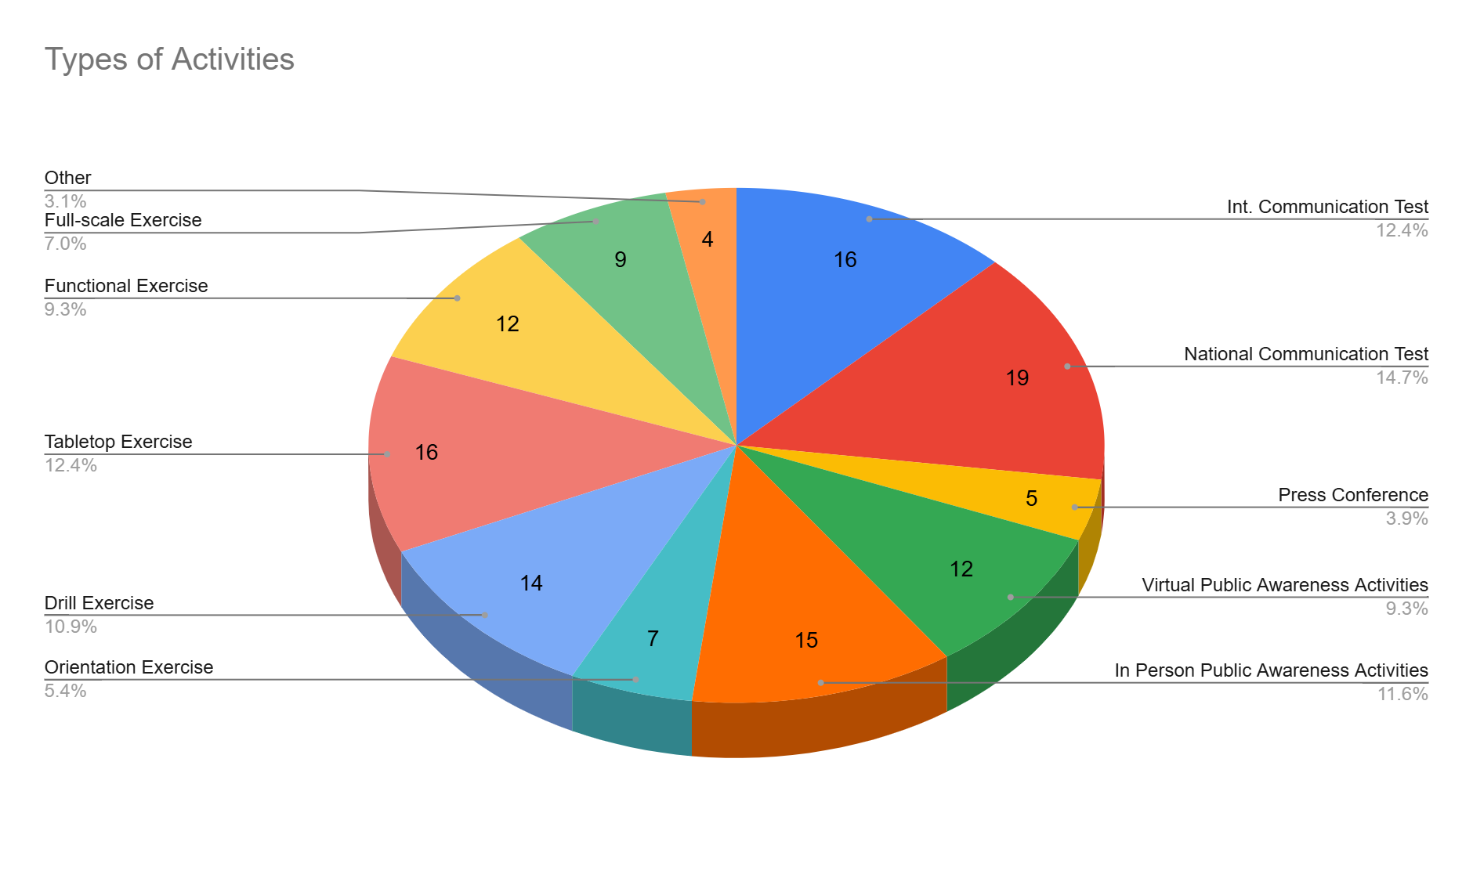
Types of Activities

Slide 20
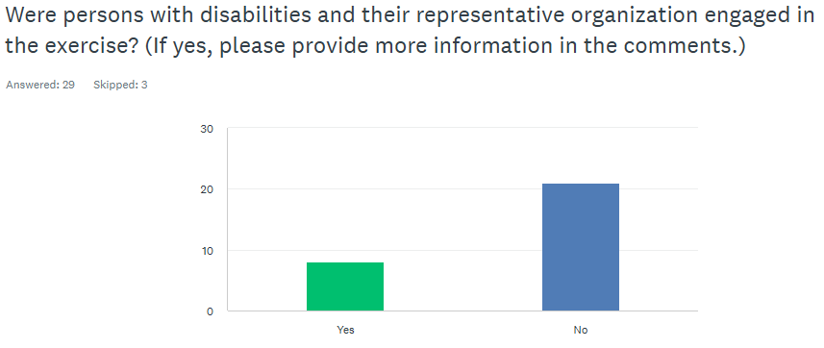
Participation of People with Disabilities
Aruba: Schools with Special Needs Kids
Barbados: Barbados Council for the Disabled gave a presentation at the Crane Hotel.
Jamaica: Jamaica Council for Persons with Disabilities (JCPD) is on the National Tsunami Contact List. Previoulsy we had reached out to other actors such as the Jamaica Society for the Blind and the Jamaica Combined Disabilities Association (an NGO) and would have been engaged as part of the exercise. The SMS blasts achieved through DIGICEL and FLOW would also have reached Persons with Disabilities (PWD).
Haiti: One hundred people with disabilities have participated.
US Puerto Rico: "Intérpretes de lenguaje de señas de Puerto Rico (Jesús Burgos)" and National Federation for the Blind.
UK - Cayman Islands: Participants were encouraged to plan on how they would vertically evacuate persons with limited mobility. A school for persons with disabilities participated and activated their plan for wheelchair users.
Venezuela: People with disabilities were monitored by state and can be seen on the Kobox dashboard.

Slide 21
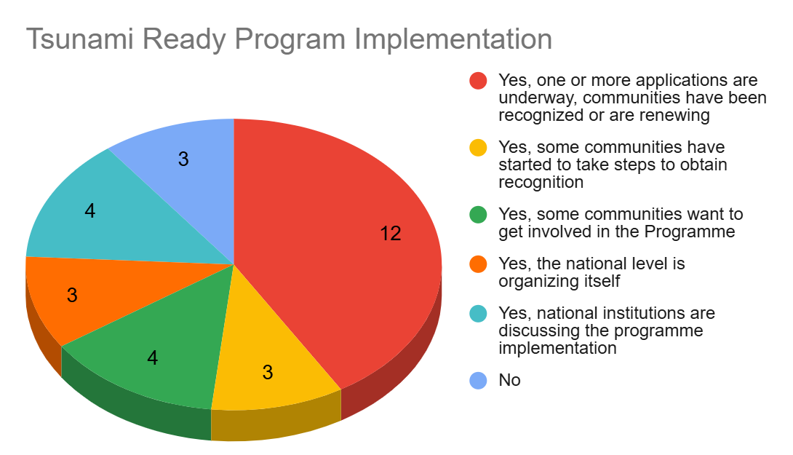
Tsunami Ready Program Implementation
The results for the status of the implementation of the UNESCO/IOC Tsunami Ready Recognition Programme indicated that 76% MS and territories have implemented or are in the process of implementing the program, while 17% interested for those who have not yet implemented it, with 394 as the total number of target communities to be recognized as Tsunami Ready

Slide 22
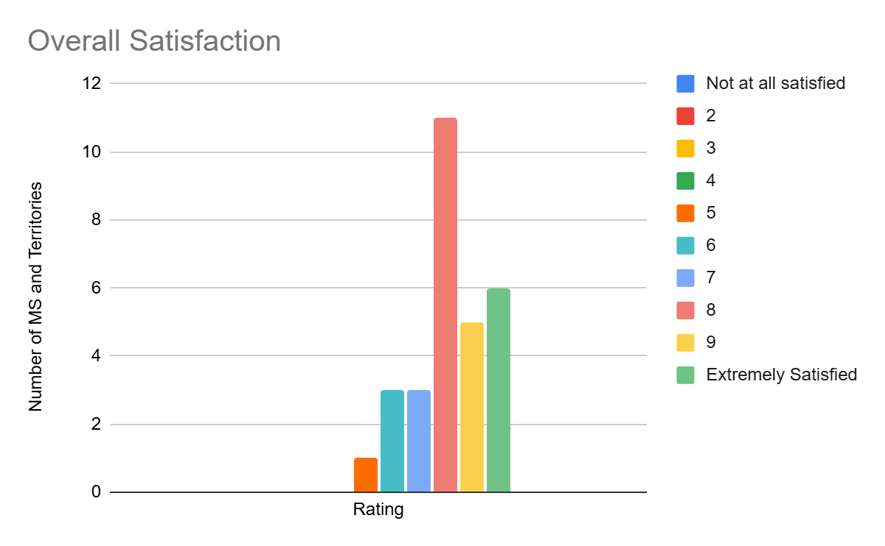
Overall Exercise Satisfaction
Anguilla: Most of our pre was pertaining to earthquakes related. So these products were a bit different and took some time for us to read.
British Virgin Islands: Less participation this year.
Panama: We have no support for field and evacuation procedures.
Venezuela: It was very good, because we had to think about a tsunami product of a volcanic eruption, imagine a landslide have the potential to producing a tsunami, and educate our authorities and staff about the possibility of a volcanic eruption that affects us.
Barbados: Largest issue was communication along with CAP. CAP and radio interrupts only allowed on two stations.
US Virgin Islands: Many of the schools had testing going on at the same time and were unable to participate in the evacuation drill.
Jamaica: Caribe Wave 2026 commanded a greater reach this year with the addition of the SMS messages.

Slide 23
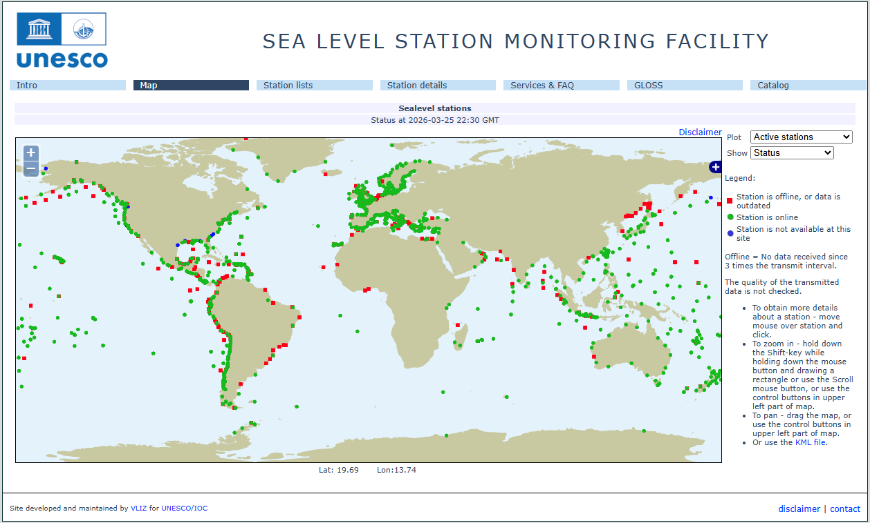
Status of Sea Level Stations during the exercise
Western Muertos Trough scenario
Northern Panama scenario
The PTWC provided simulated forecasted maximum wave heights for 60 CARIBE EWS stations in the simulated bulletins.
Only about 76% of these sea level stations were online on the IOC Sea Level facility during the exercise period.

Slide 24
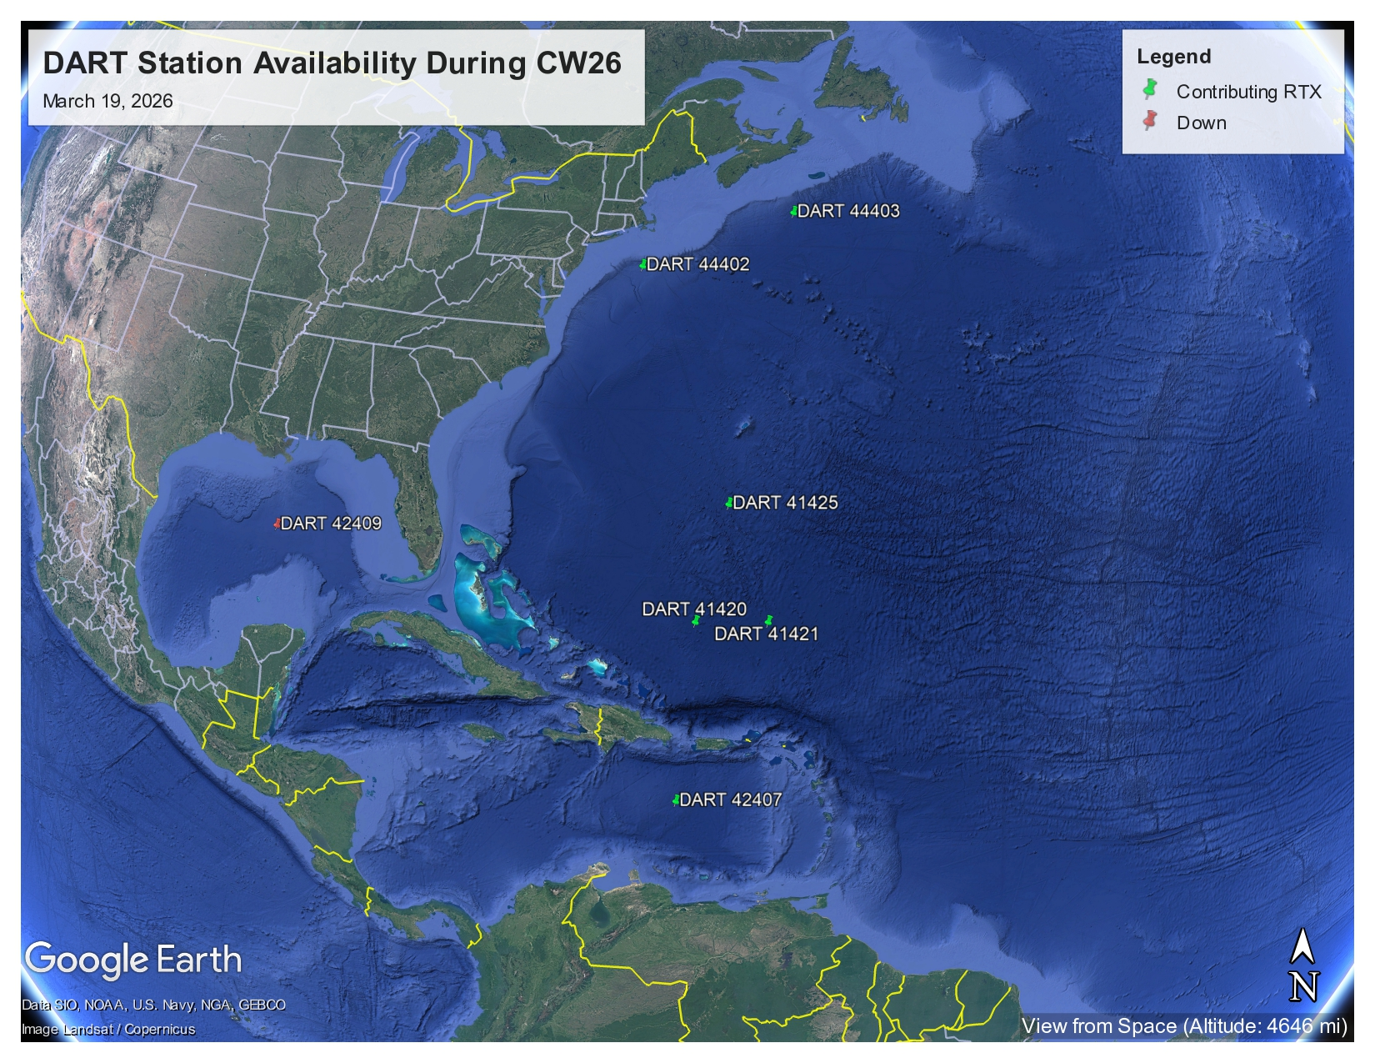
Status of DART’s
The reported DART station for Kick em Jenny was streaming data during the day of the exercise.

Slide 25
CARIBE WAVE 26 Task Team
Person | Agency | Email
Gisela Báez-Sánchez CARIBE WAVE Task Team Chair, | Puerto Rico Seismic Network, USA | gisela.baez1@upr.edu
Antonio Aguilar CARIBE WAVE Task Team Vice Chair, | FUNVISIS, Venezuela | antoniodesastres@gmail.com
Gerard Metayer CARIBE EWS Chair | Service Maritime et de Navigation Haiti | gerard_metayer@yahoo.fr
Fréderic Dondin Chair WG 1 Risk Knowledge | BGRM | fredericdondin@gmail.com
Raphaël Paris Member WG 1 Risk Knowledge | Université Blaise Pascal et CNRS-LMV | Raphael.paris@uca.fr
Elizabeth Vanacore Chair WG 2 Tsunami Detection, Analysis and Forecasting | Puerto Rico Seismic Network, USA | elizabeth.vanacore@upr.edu
Christa von Hillebrandt-Andrade Chair WG 3 Tsunami Warning Dissemination and Communication | ITIC-CAR | christa.vonh@noaa.gov
Jacob Munakwa Ngumbah Chair WG 4 Preparedness, Readiness and Resilience | NDMD, St. Kitts and Nevis | jack_dmc2011@yahoo.com
Matthieu Péroche Chair of TsunamiReady Task Team | University of Montpellier Paul-Val | mathieu.peroche@gmail.com
Erouscilla Joseph Scientific Expert – Kick em Jenny Scenario | UWI Seismic Research Centre | Erouscilla.joseph@sta.uwi.edu
Valerie Clouard Scientific Expert – Kick em Jenny Scenario | GET/OMP, Univ. Toulouse Paul Sabatier | valerie.clouard@get.omp.eu
Lemoine Anne Scientific Expert – Cayman Islands Scenario | BGRM | A.Lemoine@brgm.fr
Elizabeth Riley Director CDEMA | CDEMA | elizabeth.riley@cdema.org
Adherbal de la Rosa Toulier Executive Secretary CEPREDENAC | CEPREDENAC | cgarcia@cepredenac.org

Slide 26
CARIBE WAVE 26 Task Team
Person | Agency | Email
Lt. Colonel Daniel Polinacci Chief EMIZ Antilles | EMIZ Antilles | daniel.polinacci@martinique.pref.gouv.fr
Charles McCreery / Carolina Hincapié PTWC, USA | PTWC, USA | charles.mccreery@noaa.gov carolina.hincapie@noaa.gov
Wilfried Strauch CATAC, Nicaragua | CATAC, Nicaragua | wilfried.strauch@yahoo.com
David Wald / Kristin Marano Scientific Experts – Earthquake Impact Products | United States Geological Survey | wald@usgs.gov kmarano@usgs.gov
Alison Brome Director CTIC | CTIC | a.brome@unesco.org
Öcal Necmioglu Technical Secretary CARIBE EWS | CARIBE EWS | (up to November 2025)
Patrick Tyburn CARIBE WAVE Task Team Member | STIS, Saint Barthélemy | patrick.tyburn@sdis972.fr
José A. Tojil Jimenez CARIBE WAVE Task Team Member | INSIVUMEH | jatojil@insivumeh.gob.gt
Kaza Hippolyte CARIBE WAVE Task Team Member, | STLFS, Saint Lucia | kazagr81@hotmail.com
Lucius Lake CARIBE WAVE Task Team Member | NEOC | lucius.yl@gmail.com
Mabius Francis CARIBE WAVE Task Team Member, | STLFS, Saint Lucia | mabiusfrancis@me.com
Malcom Job CARIBE WAVE Task Team Member | National Emergency Management Organisation, Saint Lucia | job@nemo.gov.lc

Slide 27
Recommendation ICG/CARIBE-EWS-XIX
The Intergovernmental Coordination Group for the Tsunami and Other Coastal Hazards Warning System for the Caribbean and Adjacent Regions (ICG/CARIBE-EWS),
Notes the CARIBE WAVE 26 draft final, media, supplement reports and presentation,
Further notes the successful conduct of the CARIBE WAVE 26 Exercise with the participation of 94% of the Member States and over 600,000 participants,
Congratulates all the Member States who promoted, participated, and provided feedback on the CARIBE WAVE 26 exercise,
Notes 91% of the Member States provided the feedback (evaluation form) which is essential for assessing the functionality including warning, response and preparedness capabilities of CARIBE EWS and future actions,
Urges Member States to complete survey evaluations in a timely manner,

Slide 28
Recommendation ICG/CARIBE-EWS-XIX. (CONT)
Acknowledges again the good collaboration between the CARIBE WAVE Task Team, CTIC and ITIC-CAR in planning, promoting, executing, and evaluating the annual CARIBE WAVE Exercises,
Appreciates the International Tsunami Information Centre Caribbean Office (ITIC-CAR) for their support in generating the handbooks, reports and overall coordination and the Pacific Tsunami Warning Center (PTWC) and the Central America Tsunami Advisory Center (CATAC) for providing and disseminating dummy message and simulated products for the CARIBE WAVE 26,
Further appreciates the United States Geological Survey (USGS) for their continued support in generating simulated ShakeMap and PAGER products for the Cayman Islands scenario of CARIBE WAVE 26,
Recognizes the University of West Indies Seismic Research Center (UWI-SRC) and the University of Toulouse Paul Sabatier Géosciences Environnement Toulouse (GET)- l’Observatoire Midi-Pyrénées (OMP) for the development and dissemination of the Volcano Observatory Notice for tsUnami Threat (VONUT Product) for the Kick’em Jenny Volcano during CARIBE WAVE 26.

Slide 29
Resources available at caribewave.org
Manual and Guides 86: Multi-Annual Community Tsunami Exercise Programme Guidelines for the Tsunami and Other Coastal Hazards Warning System for the Caribbean and Adjacent Regions.
Revised User’s Guide for PTWC Procedures and Products for the CARIBE-EWS
IOC Manuals “How to plan, conduct and evaluate tsunami exercises” and “Module on Tsunami Exercise” are useful resources.
CARIBE WAVE 2011 - 2026 Handbook (https://unesdoc.unesco.org/ark:/48223/pf0000397125.locale=en)
CARIBE WAVE 2011 - 2025 Final Reports

Slide 30
Questions, Comments
Thank You!
Gisela Báez-Sánchez
CARIBE WAVE Chair, Puerto Rico Seismic Network, USA
Antonio Aguilar
CARIBE WAVE Vice Chair, FUNVISIS, Venezuela
Supported by:
Christa G. von Hillebrandt-Andrade
Manager, ITIC Caribbean Office
ICG CARIBE EWS WG III Chair
Kimberly Maisonet Gonzalez
Student Contractor
ITIC Caribbean Office

