Slide 1
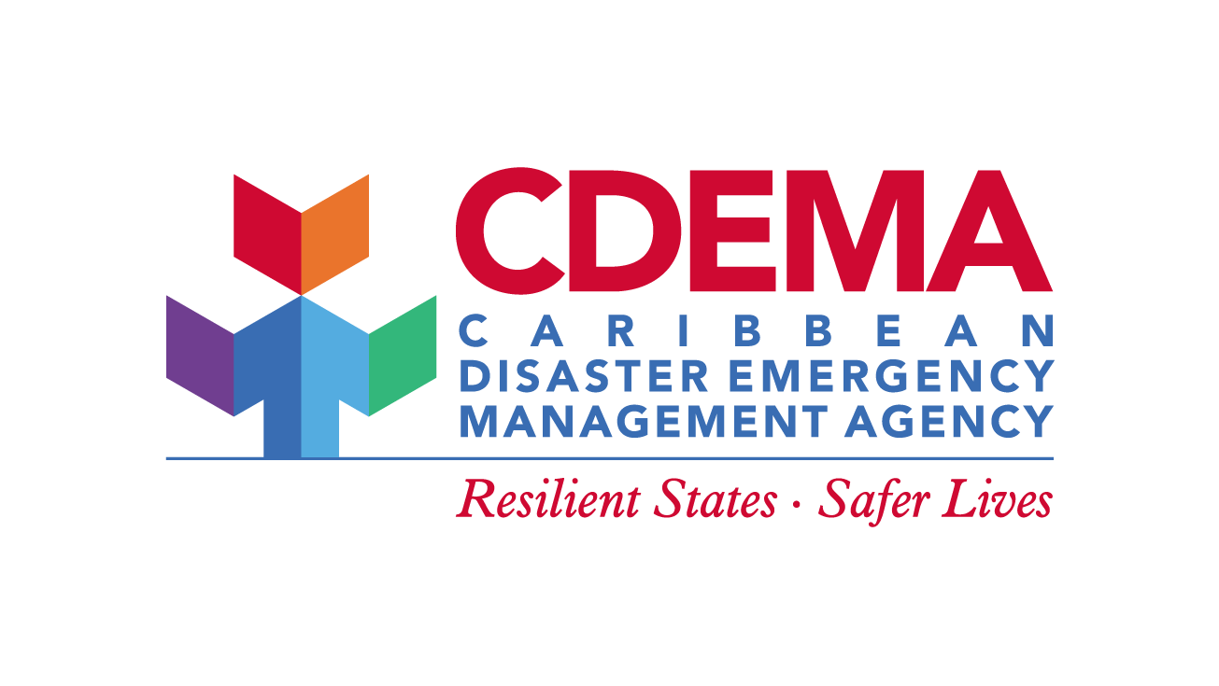
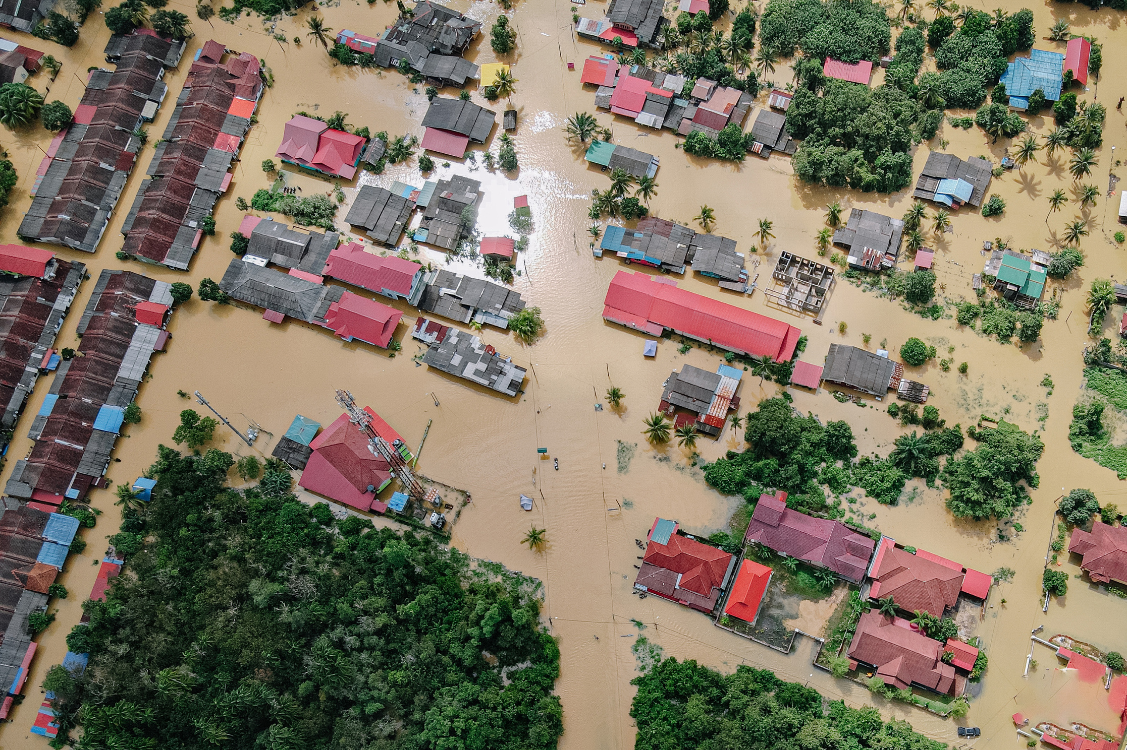
REGIONAL UPDATES
THE CDEMA PERSPECTIVE
Presentation by:
Ms. Curmira Gulston
Disaster Risk Management Specialist
Caribbean Disaster Emergency Management Agency

Slide 2
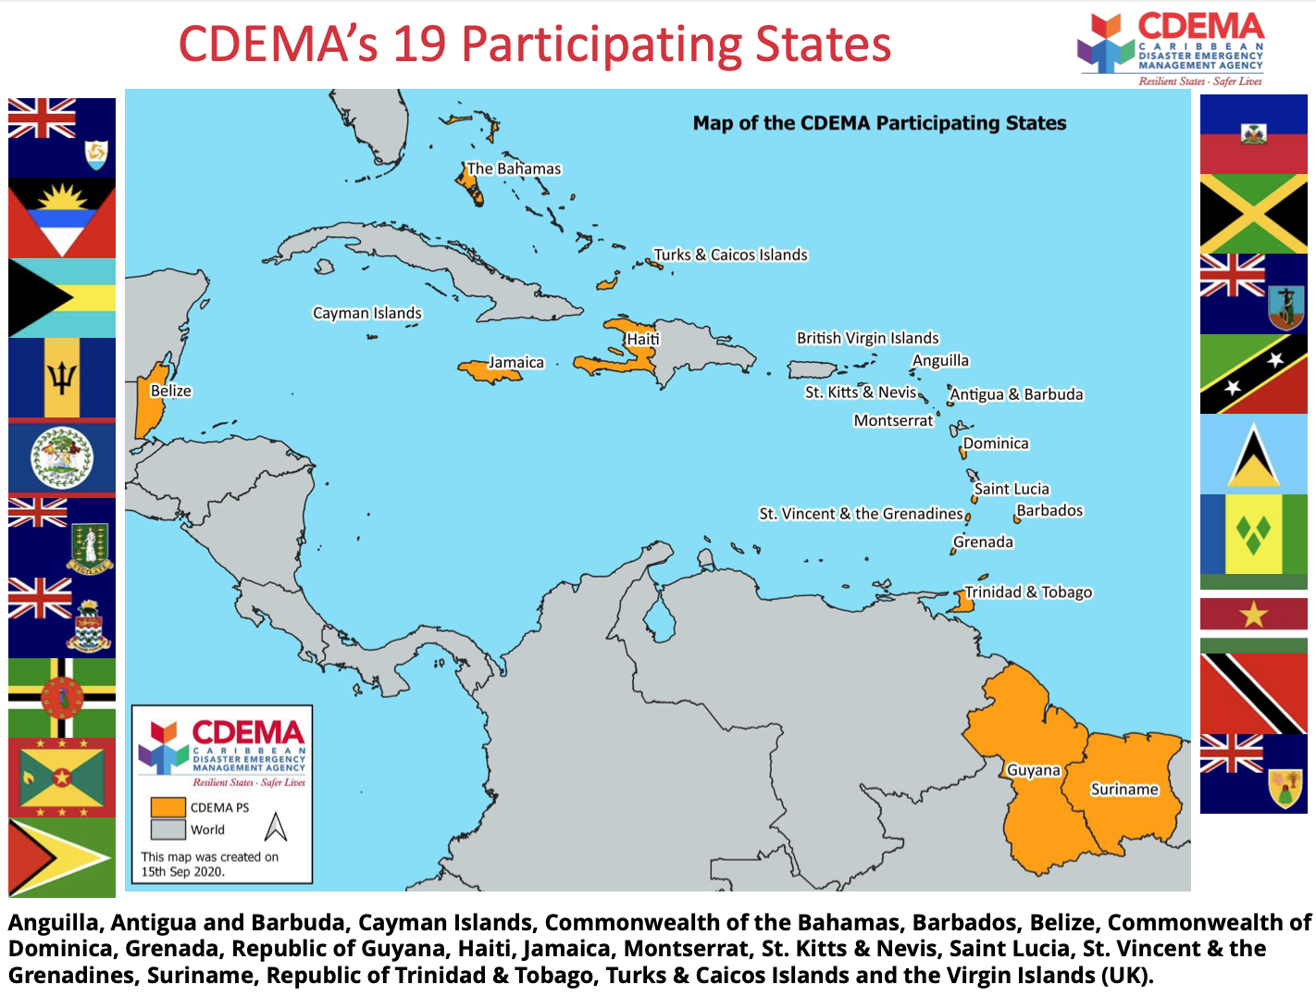
INTRODUCTION TO THE CARIBBEAN DISASTER EMERGENCY MANAGEMENT AGENCY
The CARIBBEAN EMERGENCY MANAGEMENT AGENCY is an inter-governmental agency for disaster risk management in the Caribbean Community (CARICOM).
The agency is mandated to COORDINATE DISASTER RISK MANAGEMENT across the 20 Participating States.
CDEMA promotes COMPREHENSIVE DISASTER MANAGEMENT (CDM), which is an integrated, all-hazards, all-phases approach that mainstreams DRRM into development planning and sectoral policies across the region for all peoples.

Slide 3
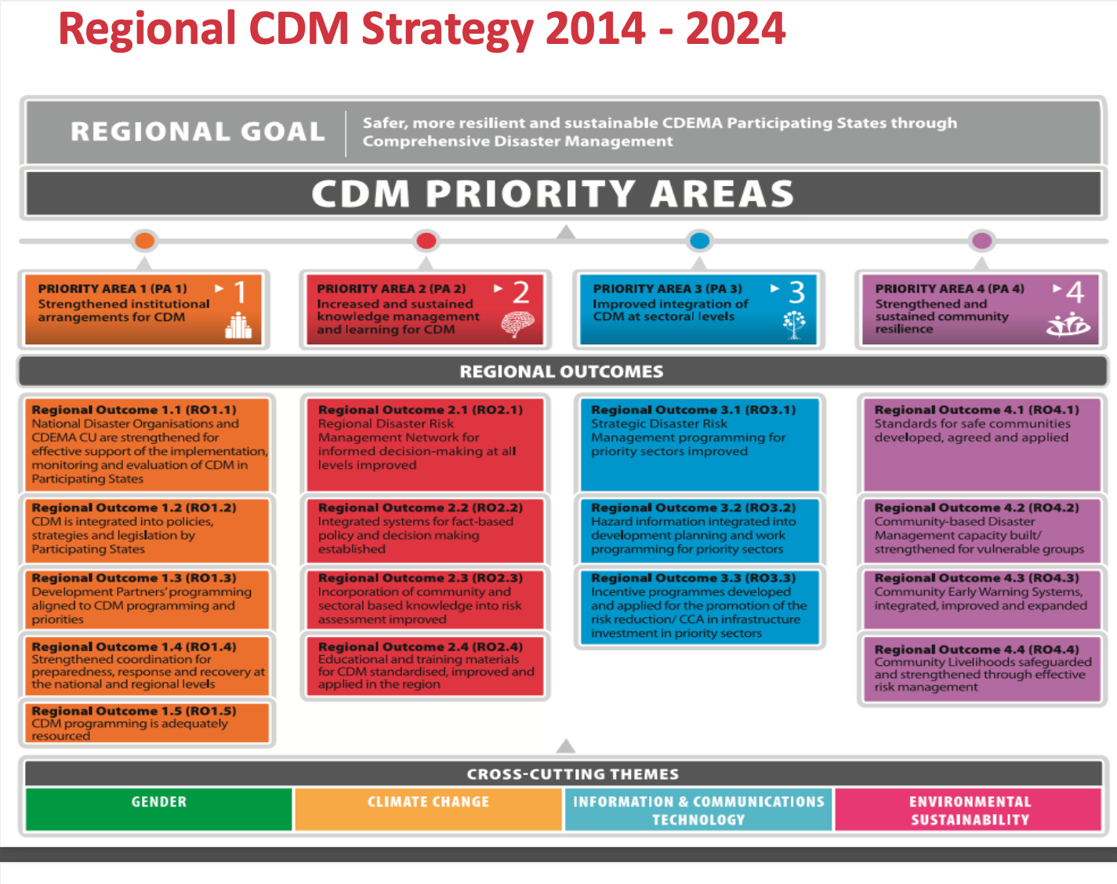
THE REGIONAL POLICY LANDSCAPE
CDEMA’s COMPREHENSIVE DISASTER MANAGEMENT STRATEGY (2015-2030) is the regional Policy Framework for DRRM priorities (hazard governance, risk information, early warning, resilient infrastructure, social protection, etc.).
Regional efforts align with global frameworks (Sendai Framework for DRR, Paris Agreement), and with CARICOM priorities: creating opportunity for national policy reform.
CDEMA has issued a number of model national policy templates and guidance documents to help states translate governance priorities into national legislation, institutional mandates, and standard operating procedures.
Notes:
understanding disaster risk, strengthening governance, investing in resilience, and enhancing preparedness for effective response and recovery.

Slide 4
WHAT ARE WE DOING…..tsunami related?
Strengthening multi-hazard early warning systems (MHEWS)
National preparedness planning
Supporting Caribe Wave exercises and Tsunami Ready Programmes
Supporting tsunami response plans
Developing risk assessment methodologies (national and community level)
Enhancing data and information management processes
Advancing public awareness & community preparedness
Mobilising resources for resilience strengthening
Creating spaces for knowledge sharing and information exchange within the region and across sectors
Developing model governance documents and tools
Regional coordination & capacity building

Slide 5
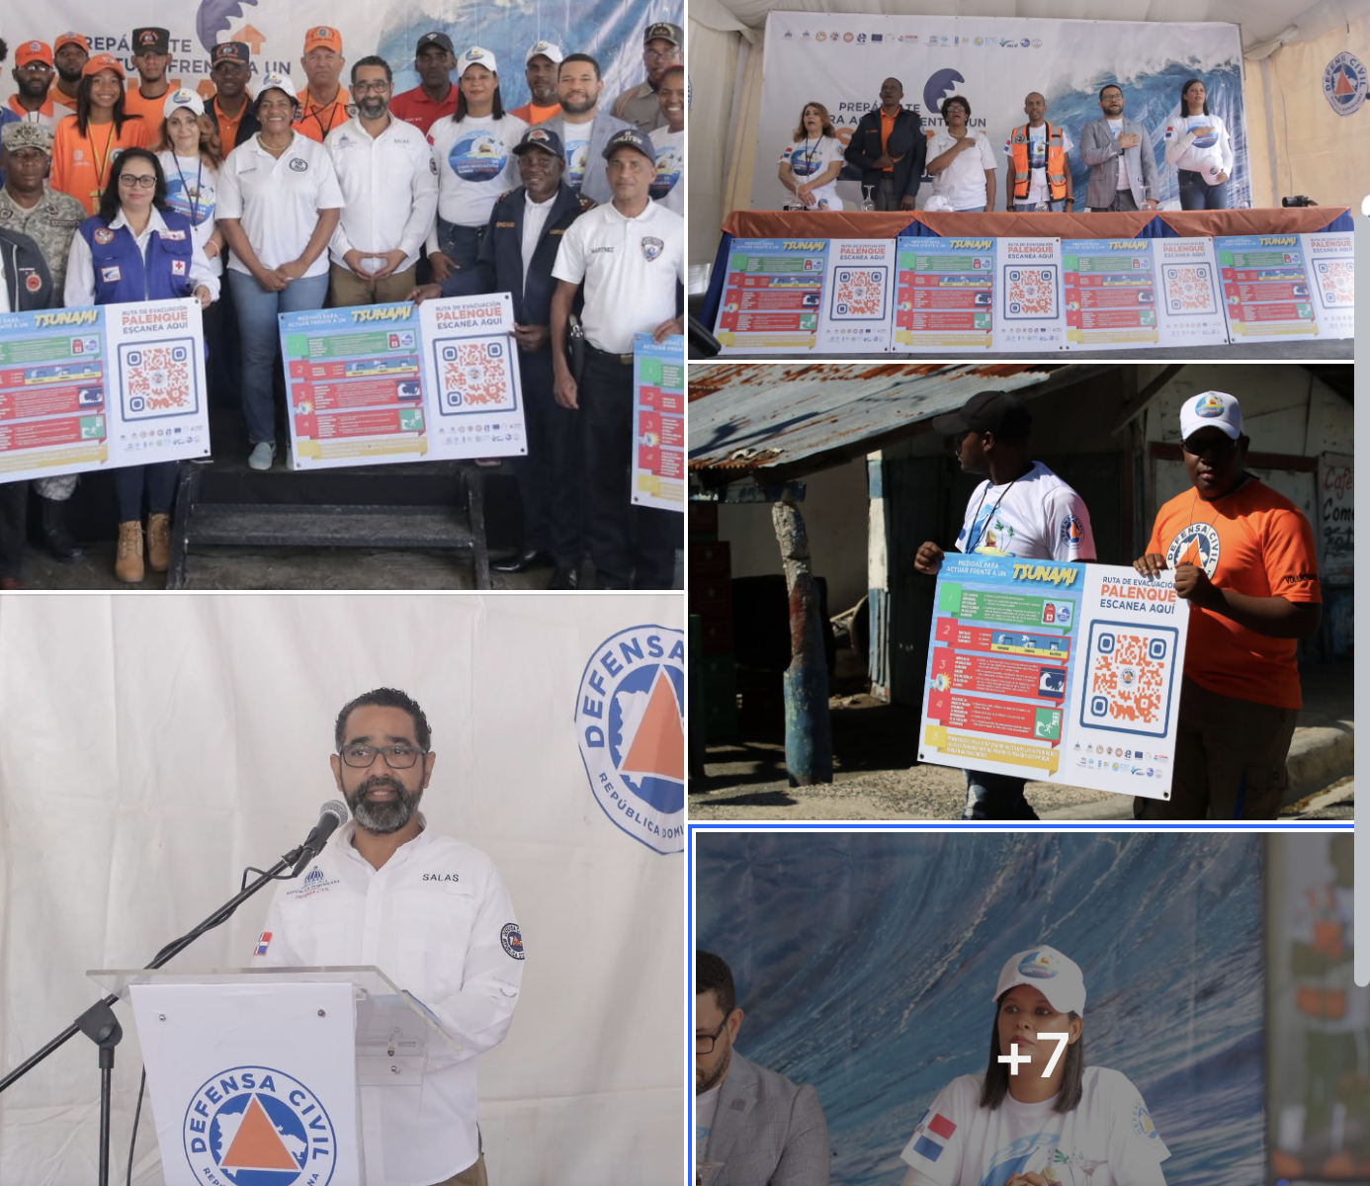
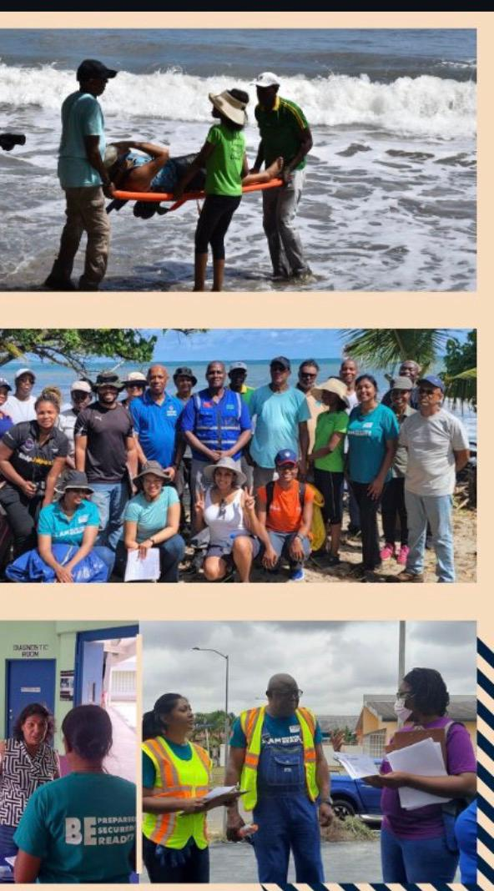
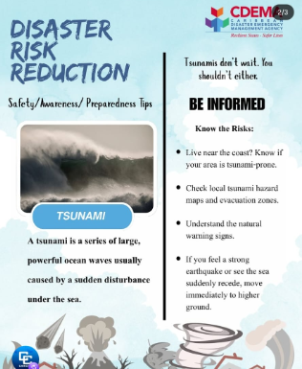
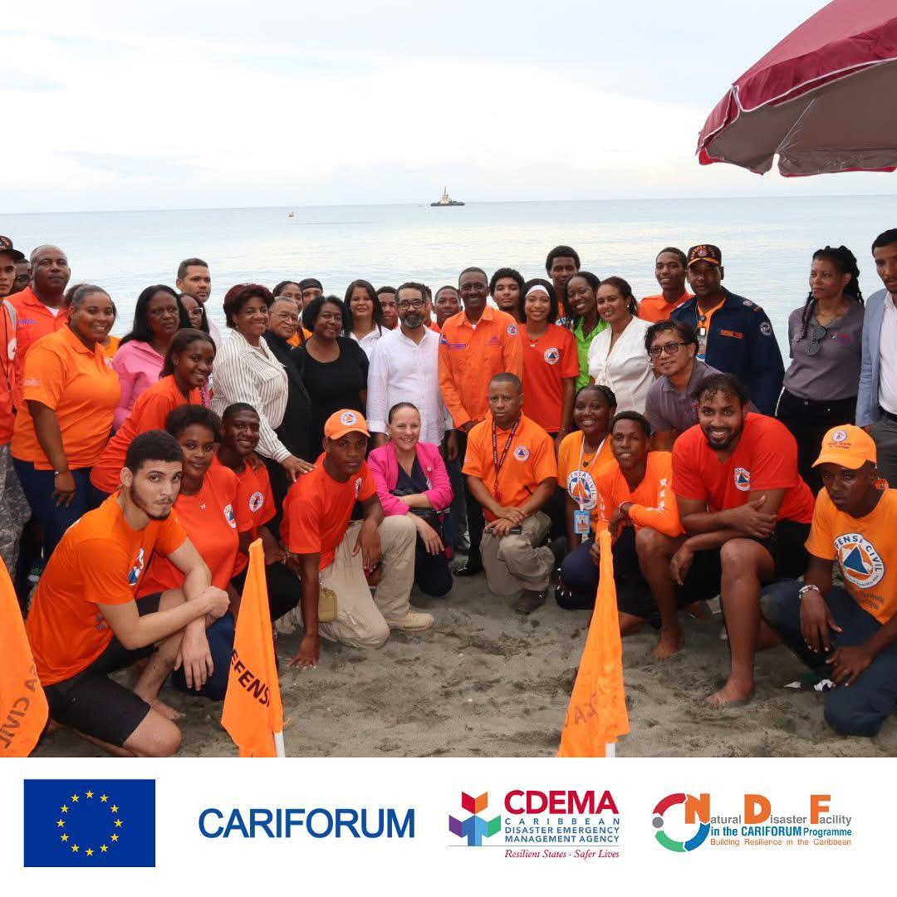

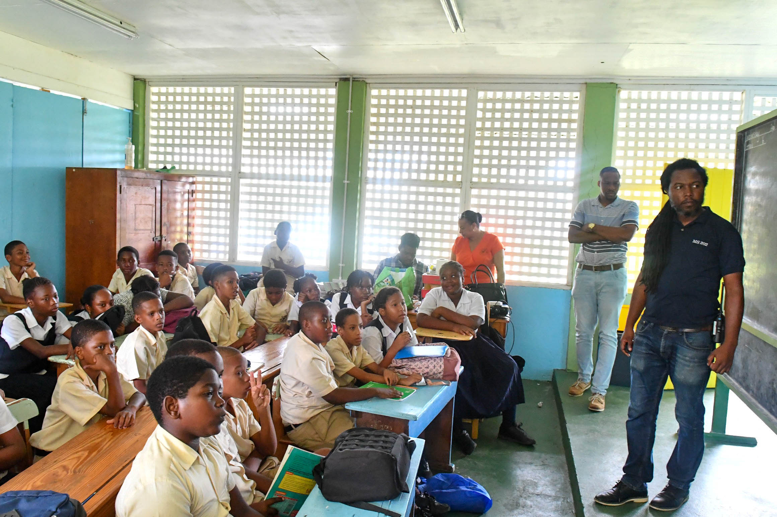
KEY HIGHLIGHTS
PROMOTING EDUCATION AND AWARENESS

Slide 6
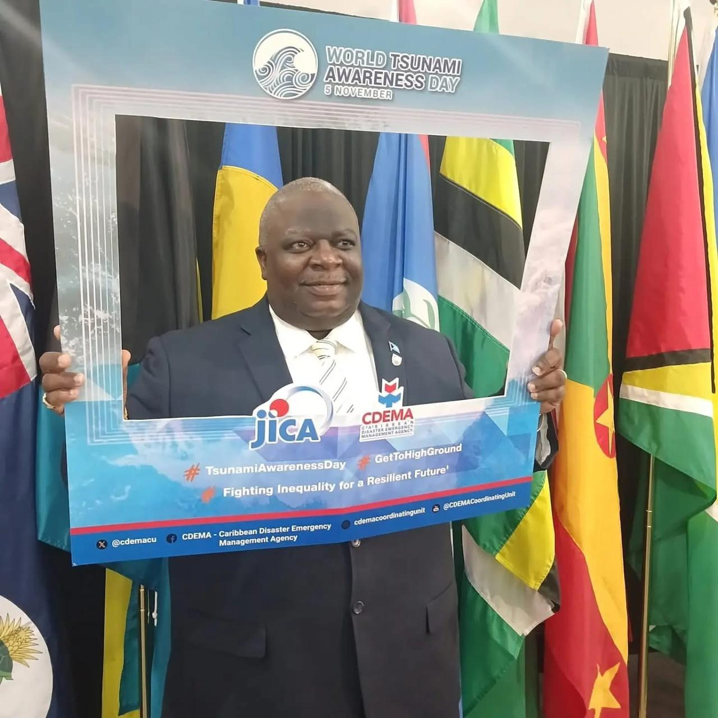
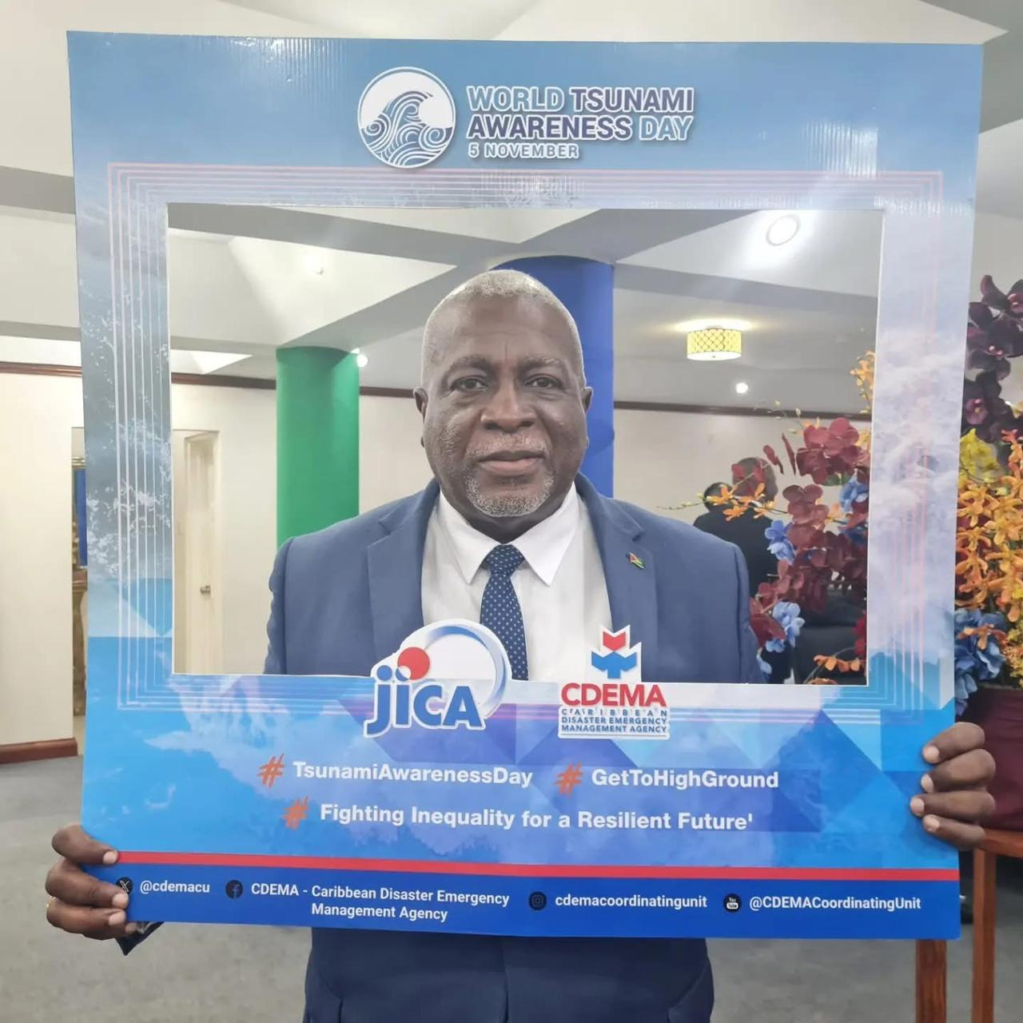
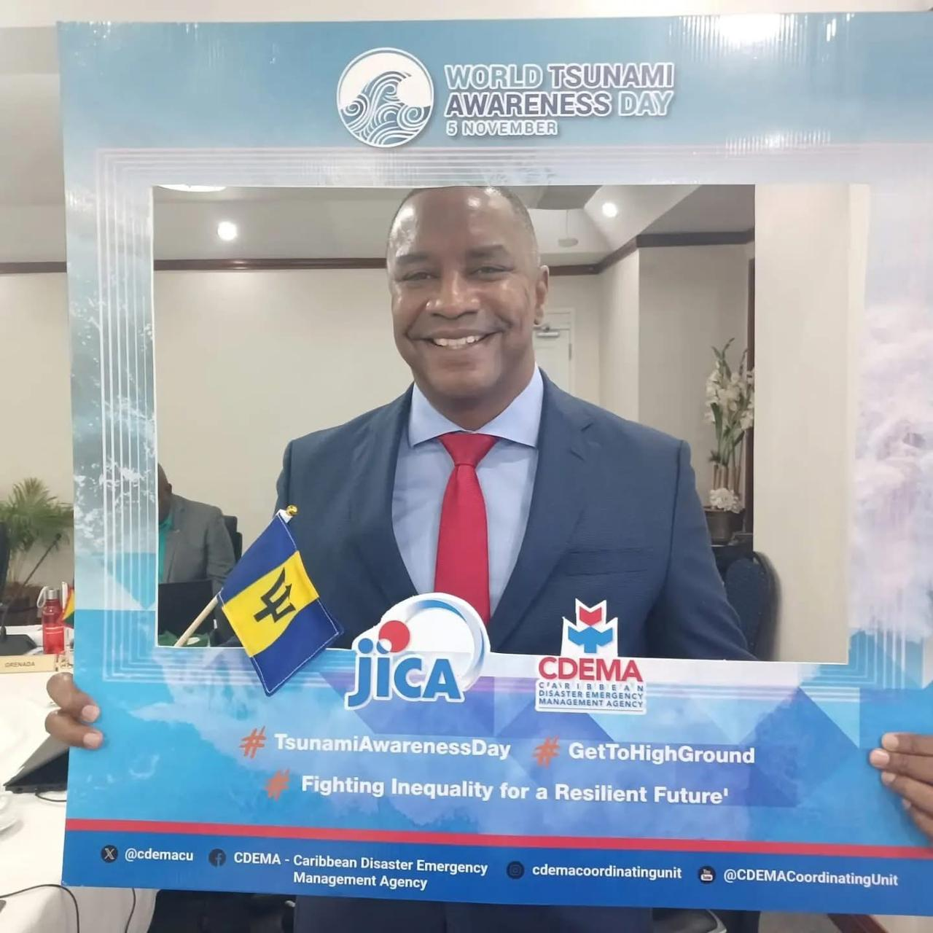
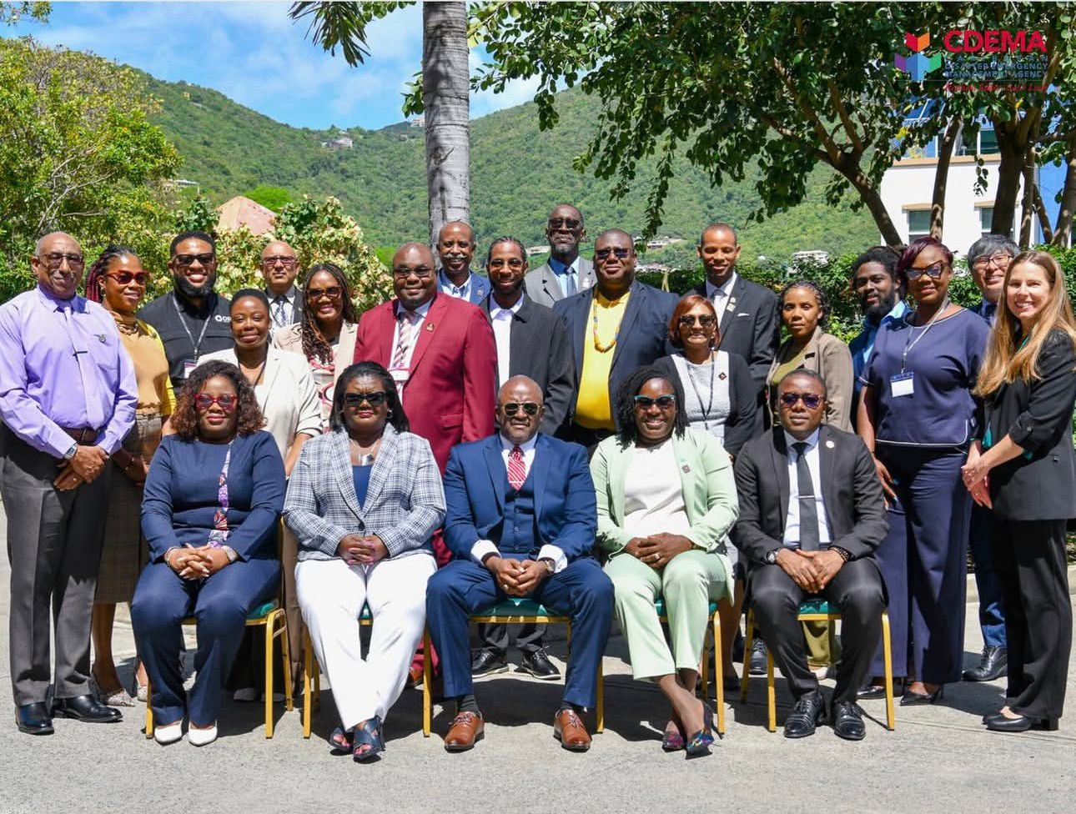
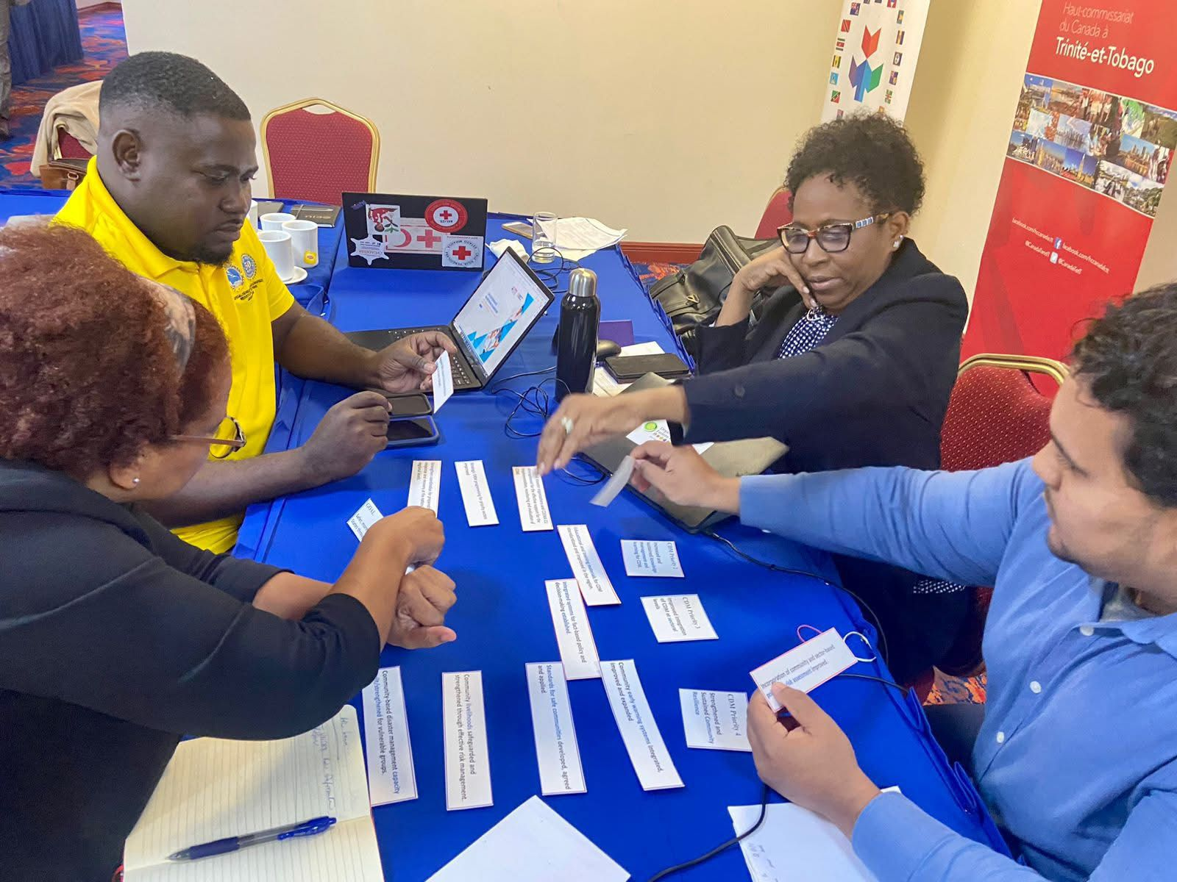
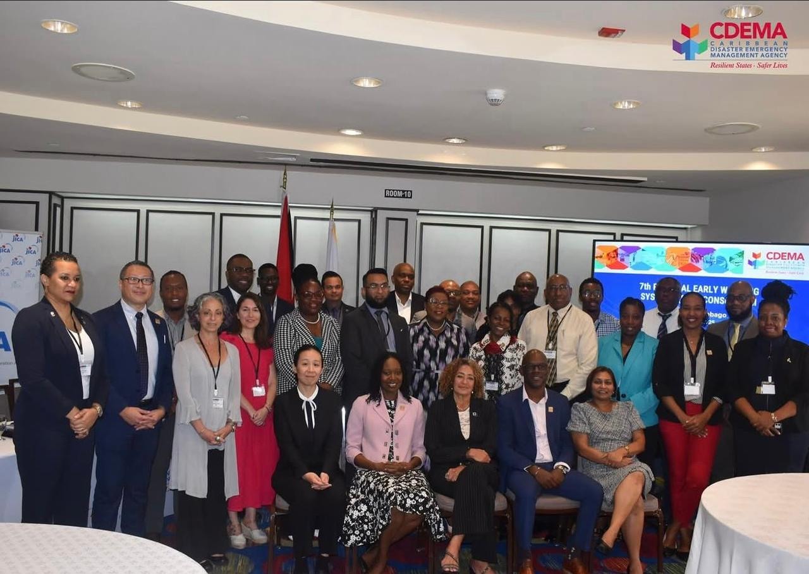
KEY HIGHLIGHTS
STRENGTHENING GOVERNANCE STRUCTURES

Slide 7
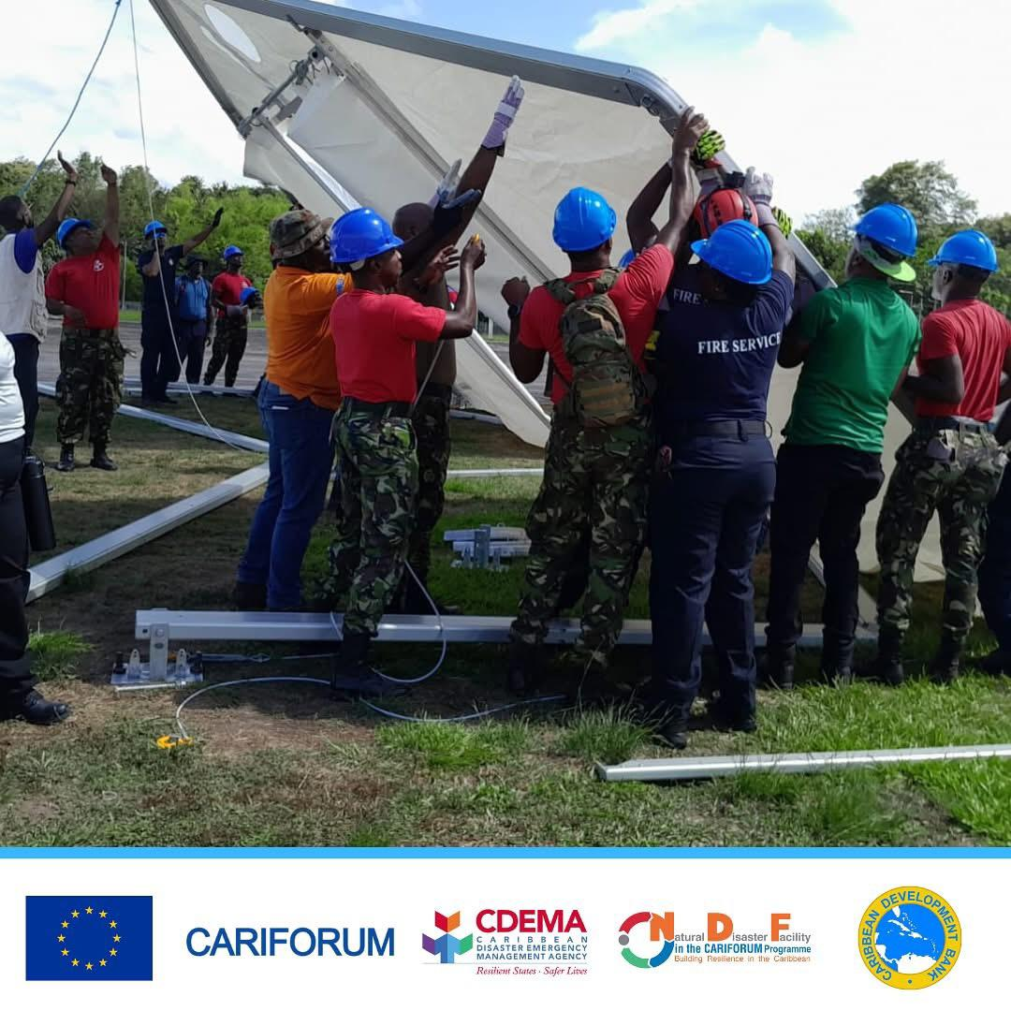
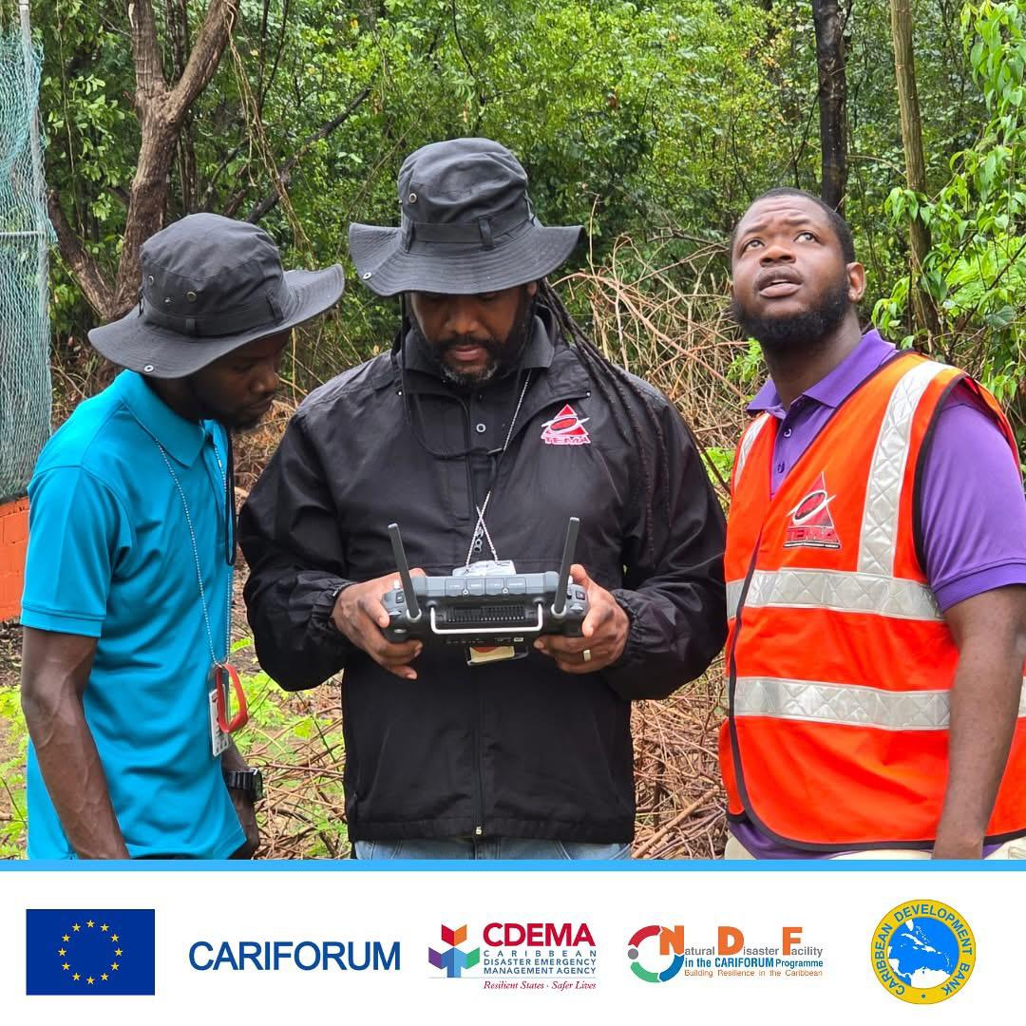
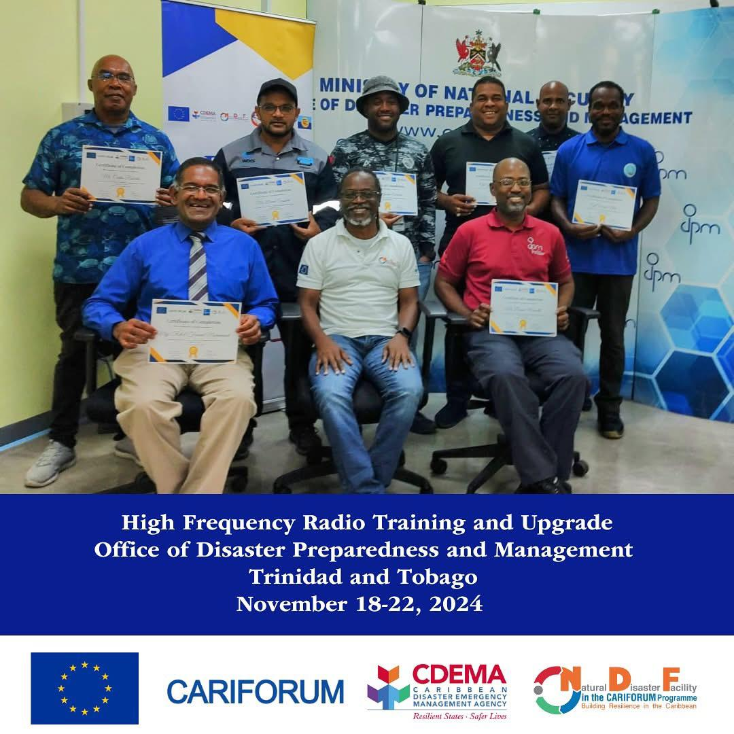
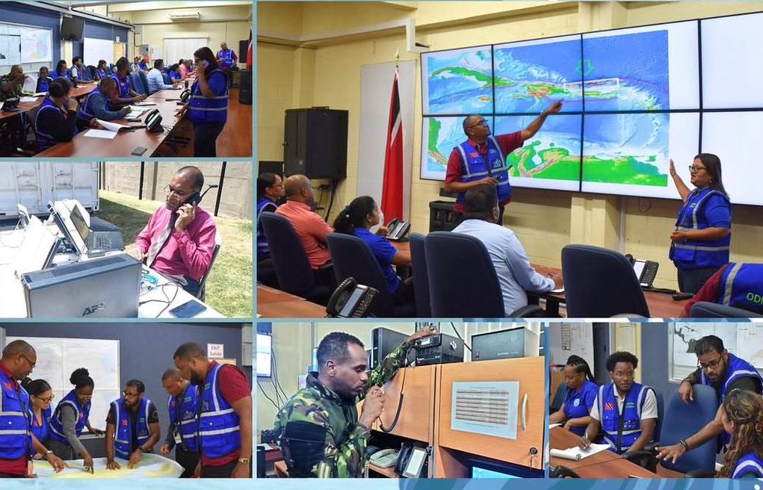
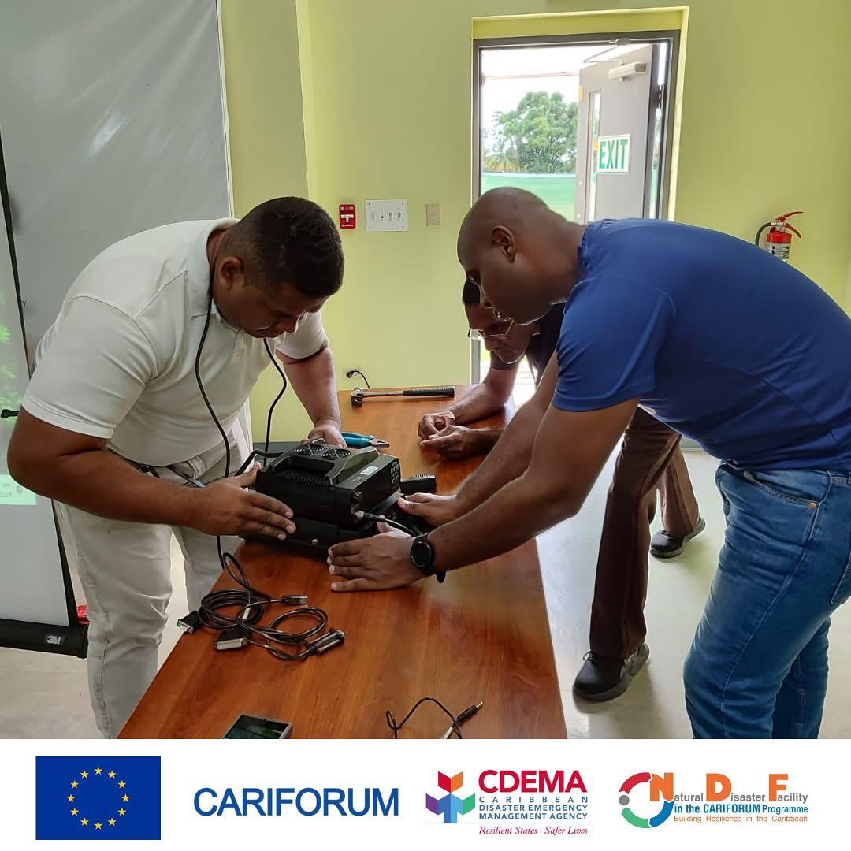
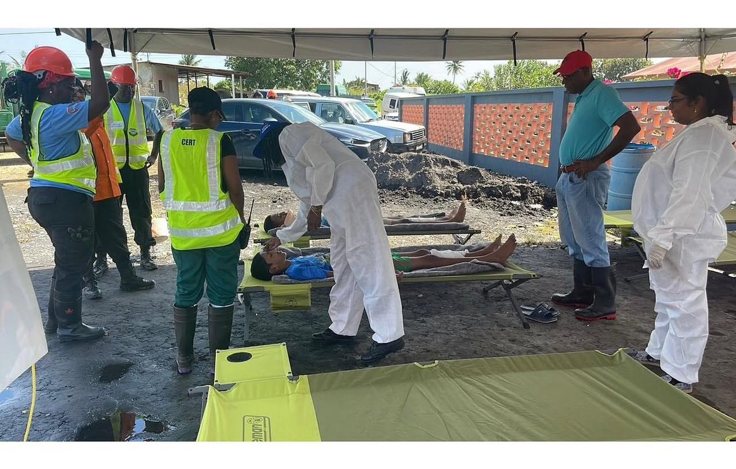
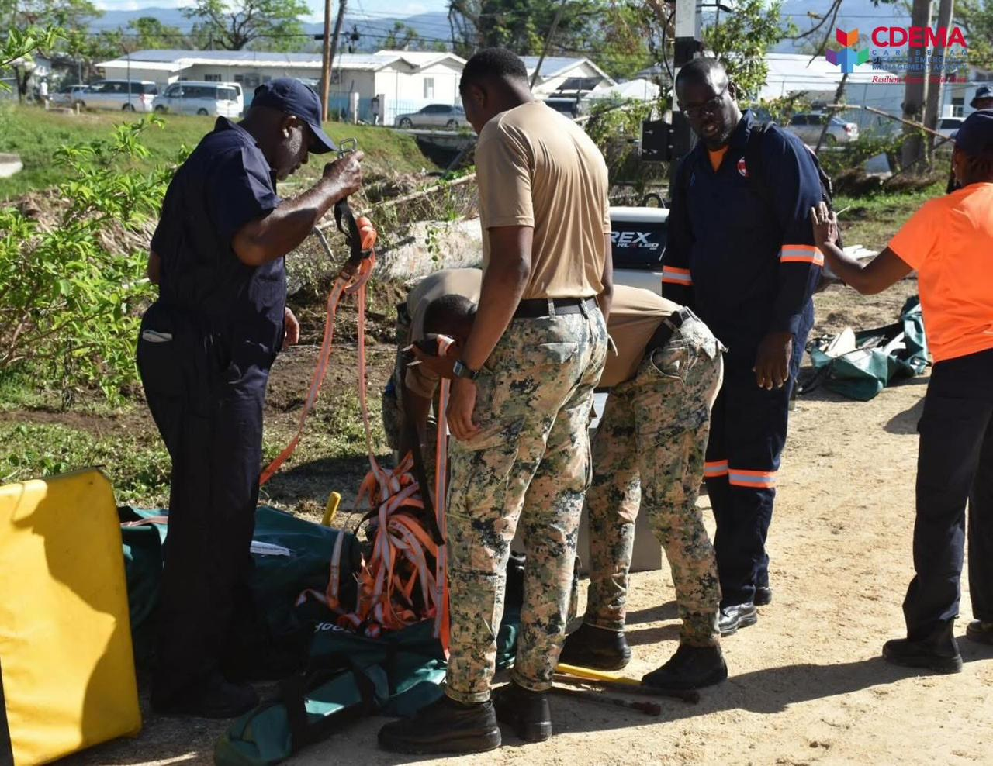
KEY HIGHLIGHTS
ENHANCING CAPACITIES

Slide 8
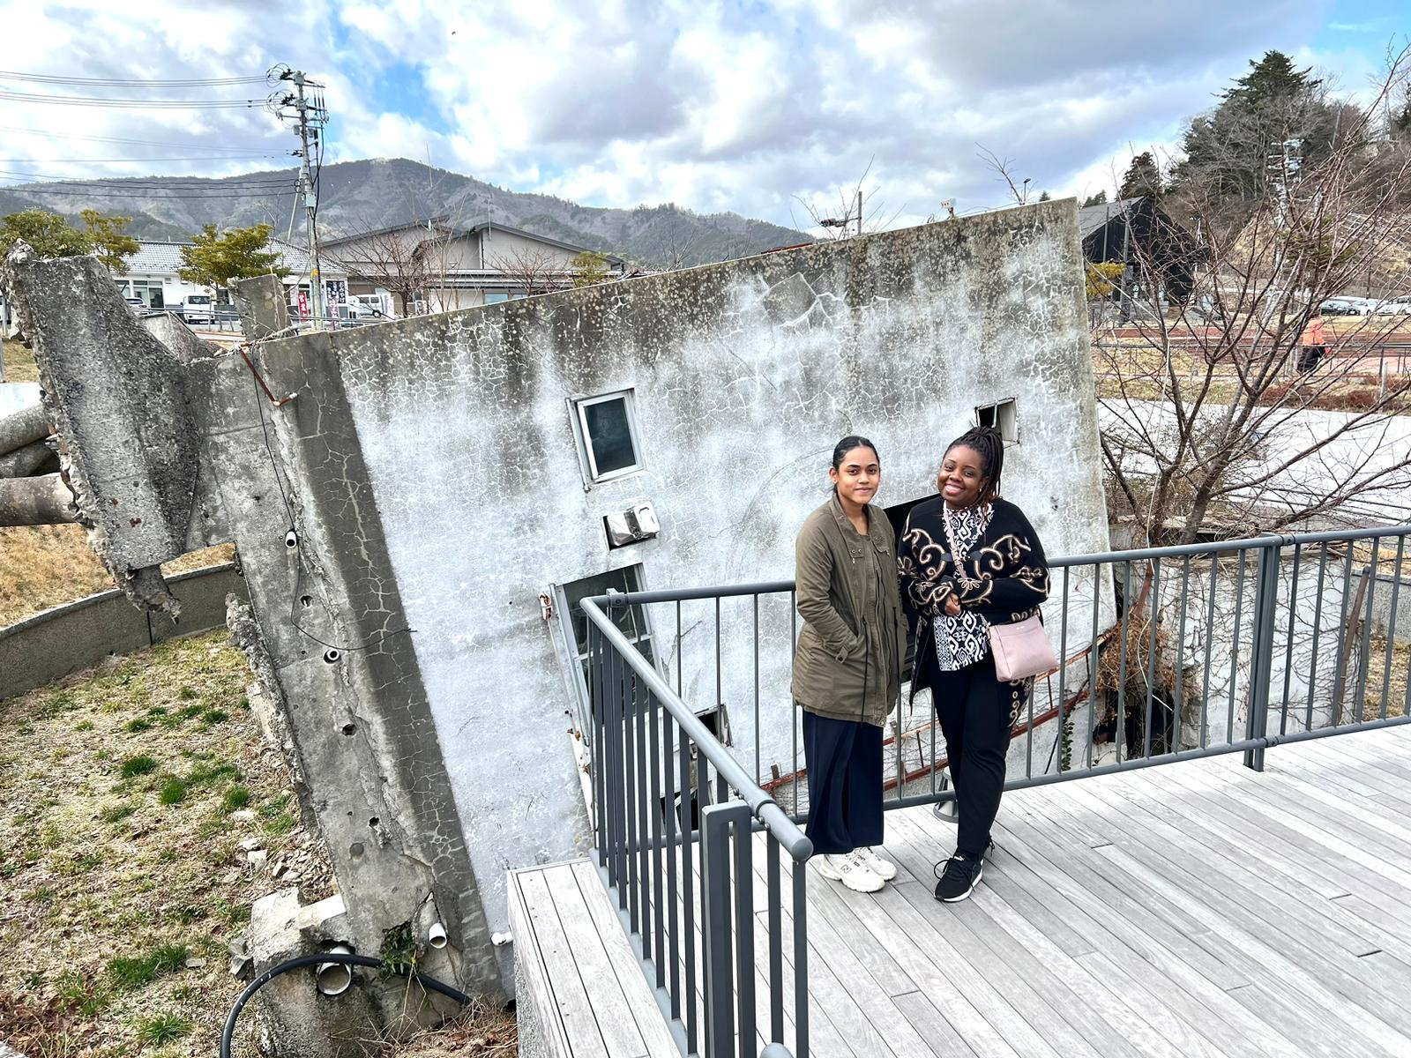
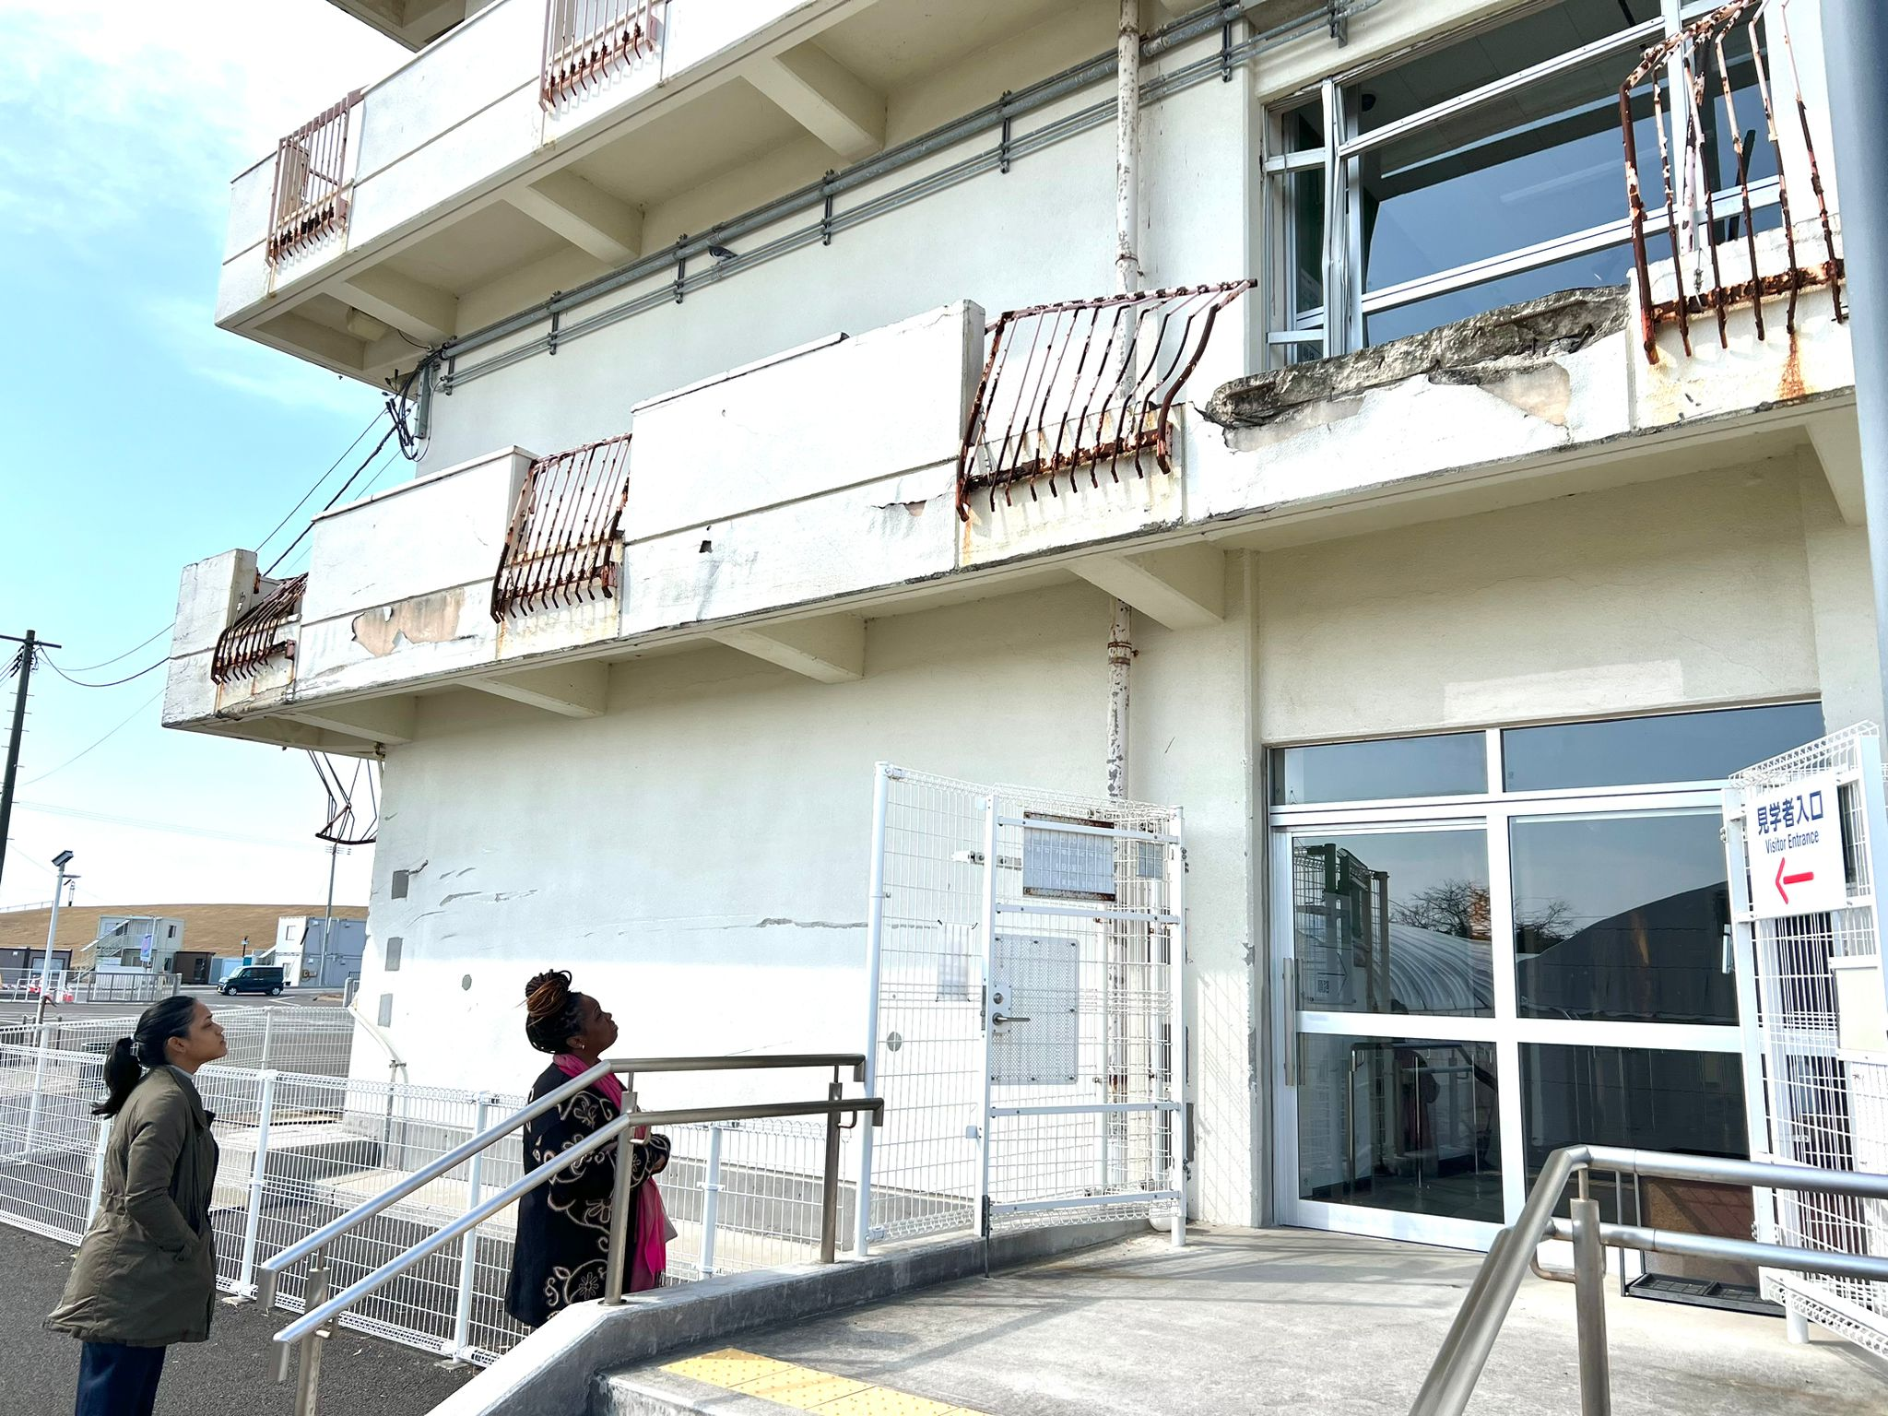
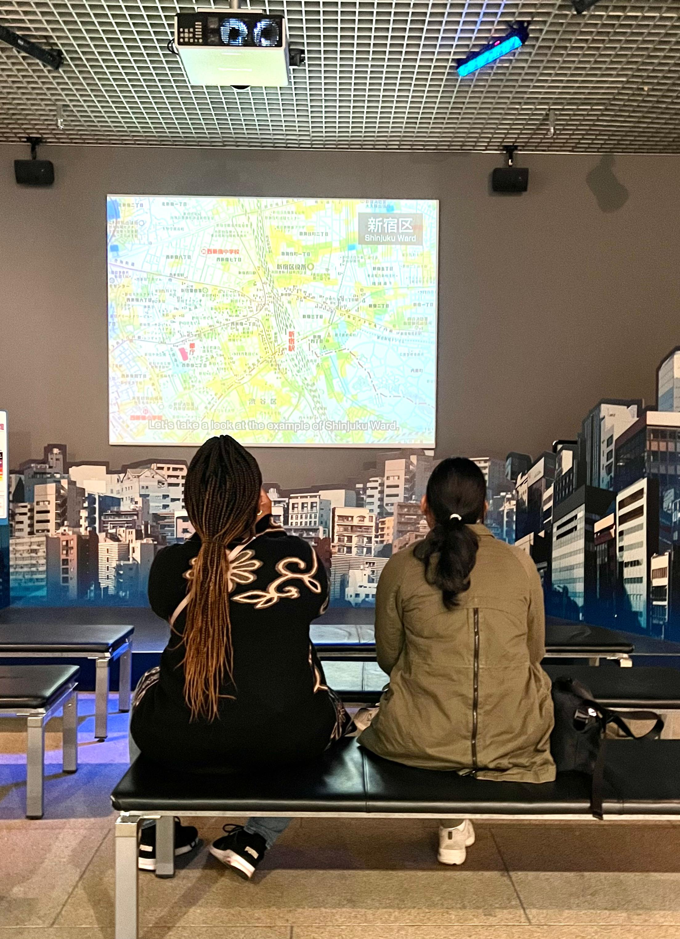
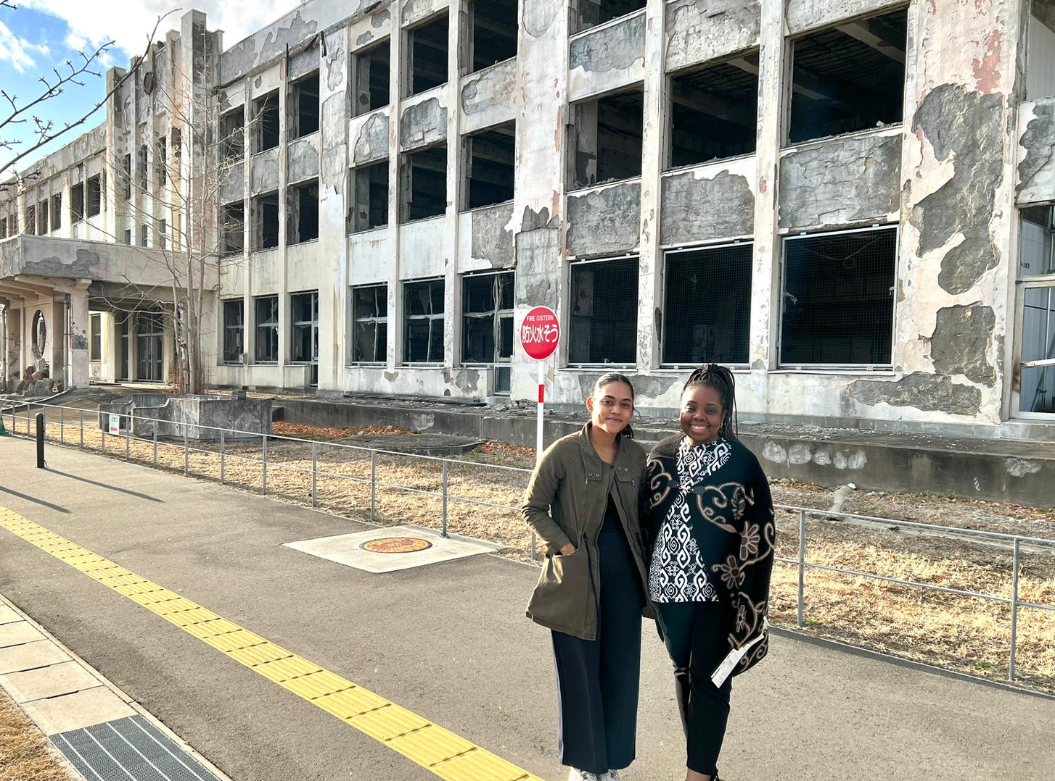
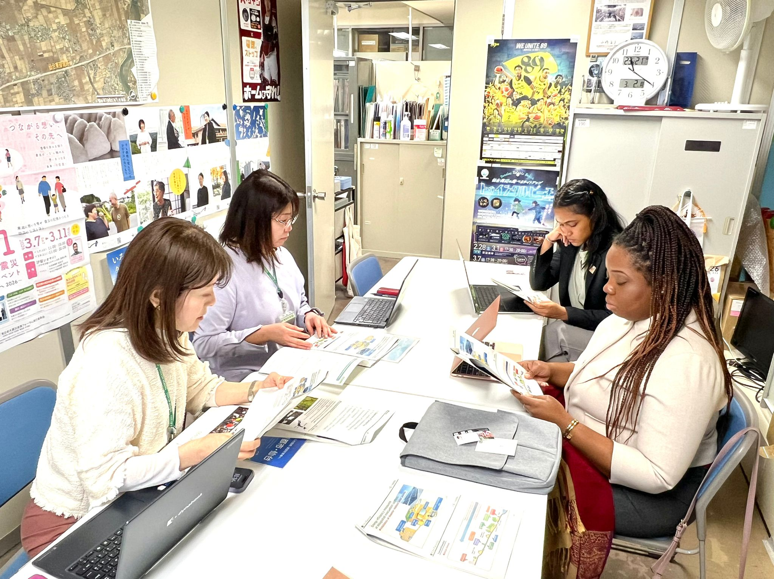
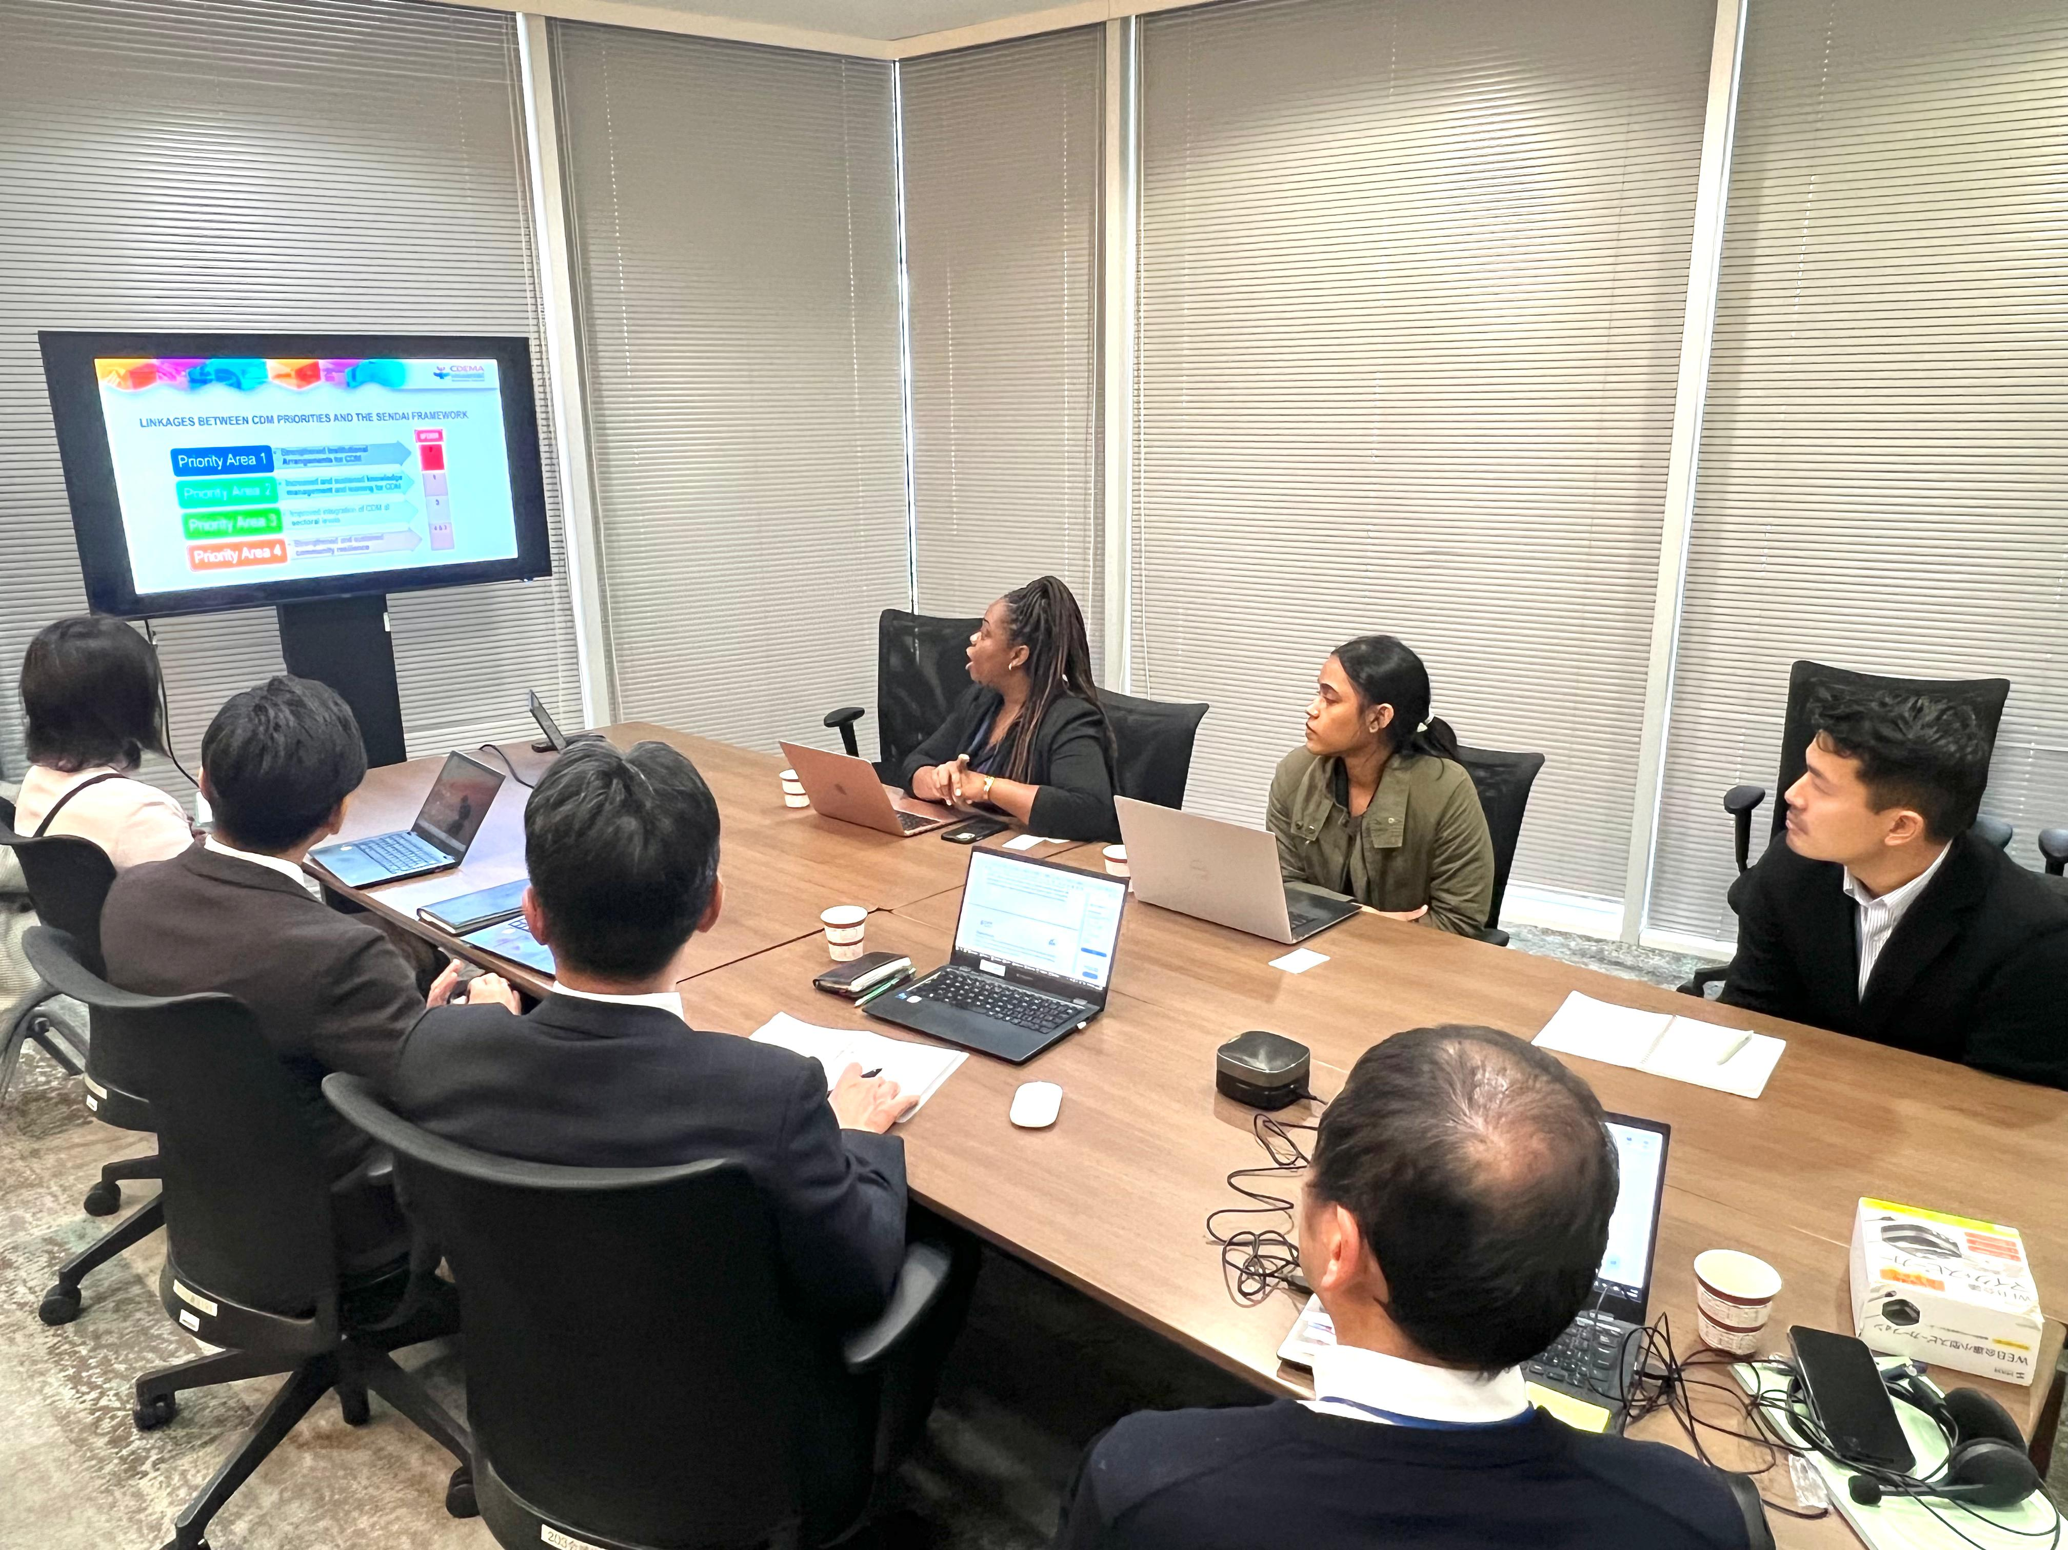
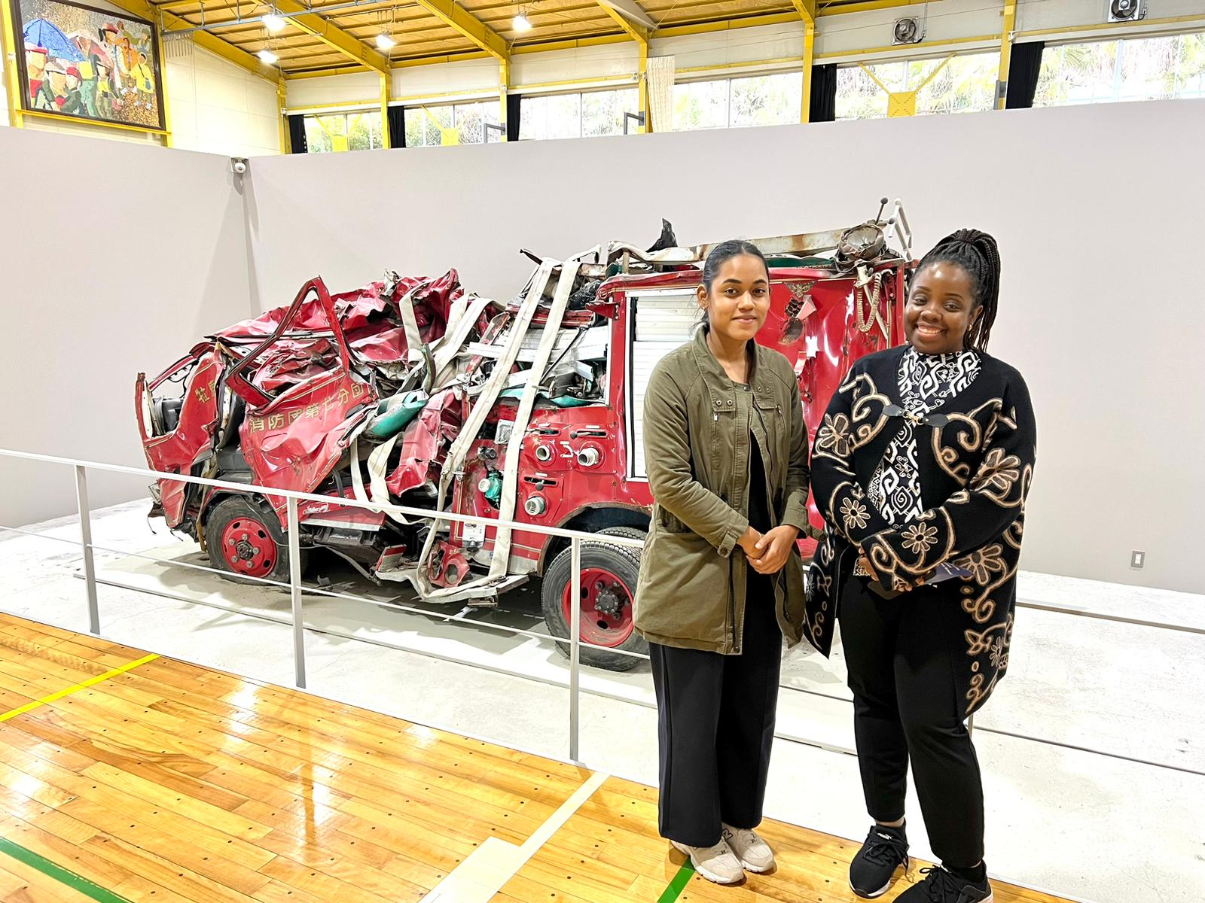
KEY HIGHLIGHTS
IMPLEMENTING KNOWLEDGE EXCHANGE

Slide 9
“Building tsunami readiness is a pathway to strengthening resilience across the Caribbean.”
THANK yOU!

