Slide 1
3.11 ICG/CARIBE-EWS WORKING GROUPS AND TASK TEAM MEMBERS LIST
ICG/CARIBE-EWS XIX
22-24 April 2026
Bernardo Aliaga Rossel
Head
Tsunami Resilience Section

Slide 2
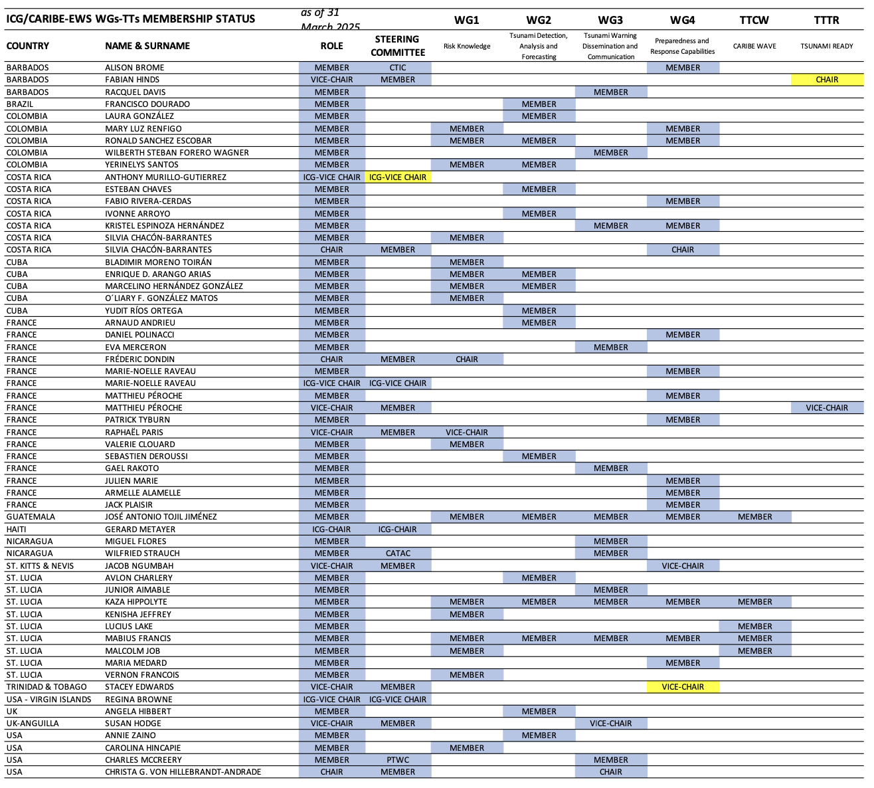
ICG/CARIBE-EWS WGs/TTs Membership Status
Member States were invited on 9 October 2023 through CL-2965 to nominate experts to the ICG/CARIBE-EWS Working Groups and Task Team.
As of 31 March 2025, there are 76 experts from 17 Member States/Territories, with the following distribution:
BARBADOS 3
BRAZIL 1
COLOMBIA 5
COSTA RICA 6
CUBA 5
FRANCE 14
GUATEMALA 1
HAITI 1
NICARAGUA 2
ST. LUCIA 9
TRINIDAD AND TOBAGO 1
UK 1
UK-ANGUILLA 1
USA 12
USA–PUERTO RICO 7
US VIRGIN ISLANDS 5
VENEZUELA 2
Delegations are invited to inform the Technical Secretary in case of any updates to the ICG/CARIBE-EWS Working Groups and Task Team Membership status.
Registration to OceanExpert is essential!

Slide 3
Intergovernmental Coordination Group for the Tsunami and Other Coastal Hazards Warning System for the Caribbean and Adjacent Regions (ICG/CARIBE-EWS)
ORGANISATIONAL STRUCTURE
2026 - 2027
Chair: Mr. Gerard Metayer (Haiti)
Vice-Chairs: Ms. Silvia Chacon Barrantes (Costa Rica), Ms. Marie-Noëlle Raveau (France/Martinique), Ms. Regina Browne (USA/Virgin Islands) Caribbean Tsunami Information Center (CTIC): Ms. Alison Brome (Barbados)
Head of the Tsunami Resilience Section and Acting Technical Secretary: Mr. Bernardo Aliaga(Chile)
Working Group 1: Risk Knowledge
Chair:
Mr. Frederic Dondin (FR)
Working Group 2: Tsunami Detection, Analysis and
Forecasting
Chair:
Ms. Elizabeth Vanacore (USA/PR)
Working Group 3:
Tsunami Warning Dissemination
and Communication
Chair:
Ms. Christa von Hillebrandt-Andrade (USA/PR)
Working Group 4: Preparedness and Response Capabilities
Chair:
Mr. Jacob Ngumbah (KN)
Task Team on CARIBE WAVE
Chair:
Ms. Gisela Baez Sanchez (USA/PR)
Vice-Chair:
Mr. O’Leary Fernando Gonzalez MATOS (CU)
Vice Chair:
Mr. Antonio Aguilar (VE)
Vice Chairs for Subgroups:
Vice Chairs for Subgroups:
Tsunami Source Identification and Characterization
Mr. Wilfried Strauch (NI)
Vice-Chair:
Mr. Trevor Queeley (UK/AI)
Preparedness and Response capabilities:
Ms. Kawana Jones (GD)
Task Team on Tsunami Ready
Chair:
Mr. Matthieu Péroche (FR)
Tsunami Detection
Ms. Gloria Romero (VE)
Mitigation:
Ms. Lidia Torres Bernhard (HN)
Tsunami Forecasting:
Mr. Chris Moore (USA)
Vice Chair:
Mr. Fabio Rivera-Cerdas (CR)

Slide 4
ICG/CARIBE-EWS WGs-TTs MEMBERSHIP STATUS |  | as of 24 September 2025 | WG-1
COUNTRY/ORGANIZATION | NAME & SURNAME | AFFILIATION | Risk Knowledge
FRANCE | FRÉDERIC DONDIN | BRGM | CHAIR
COLOMBIA | RONALD SANCHEZ ESCOBAR | GMD | MEMBER
COLOMBIA | YERINELYS SANTOS | GMD | MEMBER
CUBA | ENRIQUE D. ARANGO ARIAS | CNIS | MEMBER
CUBA | MARCELINO HERNÁNDEZ GONZÁLEZ | ICM | MEMBER
GUATEMALA | JOSÉ ANTONIO TOJIL JIMÉNEZ | INSIVUMEH | MEMBER
ST. LUCIA | KAZA HIPPOLYTE | STLFS | MEMBER
ST. LUCIA | MABIUS FRANCIS | STLFS | MEMBER
USA - PUERTO RICO | ALBERTO LOPEZ | PRSN | MEMBER
USA | CHRISTOPHER MOORE | PMEL | MEMBER
COLOMBIA | MARY LUZ RENFIGO | GMD | MEMBER
COSTA RICA | SILVIA CHACÓN-BARRANTES | SINAMOT-UNA | MEMBER
CUBA | BLADIMIR MORENO TOIRÁN | CNIS | MEMBER
CUBA | O'LEARY FERNANDO GONZALEZ MATOS | CNIS | VICE-CHAIR
FRANCE | RAPHAËL PARIS | CNRS-LMV | MEMBER
FRANCE | VALERIE CLOUARD | GET/OMP | MEMBER
ST. LUCIA | KENISHA JEFFREY | NEMO | MEMBER
ST. LUCIA | MALCOLM JOB | NEMO | MEMBER
ST. LUCIA | VERNON FRANCOIS | NEMO | MEMBER
USA | CAROLINA HINCAPIE | PTWC | MEMBER
USA | DIEGO ARCAS | NOAA/NCEI | MEMBER
USA | NATHAN WOOD | USGS | MEMBER
USA | NICOLAS ARCOS | NOAA/NCEI | MEMBER
USA - VIRGIN ISLANDS | JOEL LETANG | VITEMA | MEMBER

Slide 5
ICG/CARIBE-EWS WGs-TTs MEMBERSHIP STATUS |  | as of 24 September 2025 | WG-2
COUNTRY/ORGANIZATION | NAME & SURNAME | AFFILIATION | Tsunami Detection, Analysis and Forecasting
USA - PUERTO RICO | ELIZABETH VANACORE | UPR | CHAIR
COLOMBIA | RONALD SANCHEZ ESCOBAR | GMD | MEMBER
COLOMBIA | YERINELYS SANTOS | GMD | MEMBER
CUBA | ENRIQUE D. ARANGO ARIAS | CNIS | MEMBER
CUBA | MARCELINO HERNÁNDEZ GONZÁLEZ | ICM | MEMBER
GUATEMALA | JOSÉ ANTONIO TOJIL JIMÉNEZ | INSIVUMEH | MEMBER
ST. LUCIA | KAZA HIPPOLYTE | STLFS | MEMBER
ST. LUCIA | MABIUS FRANCIS | STLFS | MEMBER
USA - PUERTO RICO | ALBERTO LOPEZ | PRSN | MEMBER
BRAZIL | FRANCISCO DOURADO | UERJ | MEMBER
COLOMBIA | LAURA GONZÁLEZ | GMD | MEMBER
COSTA RICA | ESTEBAN CHAVES | NU | MEMBER
COSTA RICA | IVONNE ARROYO | NU | MEMBER
CUBA | YUDIT RÍOS ORTEGA | ESGAG | MEMBER
FRANCE | ARNAUD ANDRIEU | IPGP | MEMBER
FRANCE | SEBASTIEN DEROUSSI | IPGP | MEMBER
ST. LUCIA | AVLON CHARLERY | NEMO | MEMBER
UK | ANGELA HIBBERT | NOC | MEMBER
USA | ANNIE ZAINO | EARTHSCOPE/NOTA | MEMBER
USA | CHRISTA G. VON HILLEBRANDT-ANDRADE | ITIC-CAR | MEMBER
USA | EDWARD DAVIS | NOAA/CO-OPS | MEMBER
USA | STUART WEINSTEIN | PTWC | MEMBER
USA | TIM MELBOURNE | CWU | MEMBER
USA | DANIEL MCNAMARA | EarthScope | MEMBER
USA - PUERTO RICO | BENJAMIN COLON | PRSN | MEMBER
USA - PUERTO RICO | VICTOR HUERFANO | PRSN | MEMBER
USA - VIRGIN ISLANDS | ROY WATLINGTON | CCOOS | MEMBER
USA | CHRISTOPHER MOORE | PMEL | VICE-CHAIR
NICARAGUA | WILFRIED STRAUCH | CATAC | VICE-CHAIR
VENEZUELA | GLORIA ROMERO | FVIS | VICE-CHAIR

Slide 6
ICG/CARIBE-EWS WGs-TTs MEMBERSHIP STATUS |  | as of 24 September 2025 | WG-3
COUNTRY/ORGANIZATION | NAME & SURNAME | AFFILIATION | Tsunami Warning Dissemination and Communication
USA | CHRISTA G. VON HILLEBRANDT-ANDRADE | ITIC-CAR | CHAIR
GUATEMALA | JOSÉ ANTONIO TOJIL JIMÉNEZ | INSIVUMEH | MEMBER
ST. LUCIA | KAZA HIPPOLYTE | STLFS | MEMBER
ST. LUCIA | MABIUS FRANCIS | STLFS | MEMBER
NICARAGUA | WILFRIED STRAUCH | CATAC | MEMBER
USA | CAROLINA HINCAPIE | PTWC | MEMBER
BARBADOS | RACQUEL DAVIS | BMS | MEMBER
COLOMBIA | WILBERTH STEBAN FORERO WAGNER | DIMAR | MEMBER
COSTA RICA | KRISTEL ESPINOZA HERNÁNDEZ | NU | MEMBER
FRANCE | EVA MERCERON | MeteoFrance | MEMBER
GUATEMALA | PABLO DANIEL MARTINEZ | INSIVUMEH | MEMBER
NICARAGUA | MIGUEL FLORES | CATAC | MEMBER
ST. LUCIA | JUNIOR AIMABLE | NEMO | MEMBER
UNDRR | JENNIFER GURALNICK | UNDRR | MEMBER
UNDRR | EMMA HANSEN | UNDRR | MEMBER
USA | CHARLES MCCREERY | PTWC | MEMBER
USA - PUERTO RICO | MARIA TORRES | PRSN | MEMBER
USA - VIRGIN ISLANDS | ASIM FRETT | VITEMA | MEMBER
WMO | RODNEY MARTINEZ | WMO | MEMBER
UK-ANGUILLA | TREVOR QUEELEY | DDM | VICE-CHAIR

Slide 7
ICG/CARIBE-EWS WGs-TTs MEMBERSHIP STATUS |  | as of 24 September 2025 | WG-4
COUNTRY/ORGANIZATION | NAME & SURNAME | AFFILIATION | Preparedness and Response Capabilities
ST. KITTS & NEVIS | JACOB NGUMBAH | NDM | CHAIR
USA | CHRISTA G. VON HILLEBRANDT-ANDRADE | ITIC-CAR | MEMBER
GUATEMALA | JOSÉ ANTONIO TOJIL JIMÉNEZ | INSIVUMEH | MEMBER
ST. LUCIA | KAZA HIPPOLYTE | STLFS | MEMBER
ST. LUCIA | MABIUS FRANCIS | STLFS | MEMBER
COSTA RICA | KRISTEL ESPINOZA HERNÁNDEZ | NU | MEMBER
COLOMBIA | RONALD SANCHEZ ESCOBAR | GMD | MEMBER
COLOMBIA | MARY LUZ RENFIGO | GMD | MEMBER
COSTA RICA | SILVIA CHACÓN-BARRANTES | SINAMOT-UNA | MEMBER
UNESCO/IOC/CTIC | ALISON BROME | UNESCO/IOC/CTIC | MEMBER
COSTA RICA | FABIO RIVERA-CERDAS | NU | MEMBER
FRANCE | ARMELLE ALAMELLE | PREFECTURE GUADELOUPE | MEMBER
FRANCE | DANIEL POLINACCI | EMIZA | MEMBER
FRANCE | ELOISE MERCUEL | PREFECTURE ST MARTIN & ST BATHELEMY | MEMBER
FRANCE | JULIEN MARIE | PREFECTURE MARTINIQUE | MEMBER
FRANCE | MARIE-NOELLE RAVEAU | HCTM | MEMBER
FRANCE | MATTHIEU PÉROCHE | UNIV MONTPELLIER 3 | MEMBER
FRANCE | PATRICK TYBURN | STIS | MEMBER
ST. LUCIA | MARIA MEDARD | NEMO | MEMBER
TRINIDAD & TOBAGO | STACEY EDWARDS | UWI | MEMBER
USA - PUERTO RICO | ROY RUIZ | PRSN | MEMBER
USA - VIRGIN ISLANDS | REGINA BROWNE | USVI | MEMBER
GRENADA | KAWANA JONES | YEAC | VICE-CHAIR
HONDURAS | LIDIA TORRES BERNHARD | UNAH | VICE-CHAIR

Slide 8
ICG/CARIBE-EWS WGs-TTs MEMBERSHIP STATUS |  | as of 24 September 2025 | TT-CW
COUNTRY/ORGANIZATION | NAME & SURNAME | AFFILIATION | CARIBE WAVE
USA - PUERTO RICO | GISELA BAEZ-SANCHEZ | UPR | CHAIR
GUATEMALA | JOSÉ ANTONIO TOJIL JIMÉNEZ | INSIVUMEH | MEMBER
ST. LUCIA | KAZA HIPPOLYTE | STLFS | MEMBER
ST. LUCIA | MABIUS FRANCIS | STLFS | MEMBER
FRANCE | PATRICK TYBURN | STIS | MEMBER
FRANCE | VALERIE CLOUARD | GET/OMP | MEMBER
ST. LUCIA | MALCOLM JOB | NEMO | MEMBER
ST. LUCIA | LUCIUS LAKE | NEOC | MEMBER
TRINIDAD & TOBAGO | EROUSCILLA P JOSEPH | SRC-UWI | MEMBER
VENEZUELA | ANTONIO R. AGUILAR | FVIS | VICE-CHAIR

Slide 9
ICG/CARIBE-EWS WGs-TTs MEMBERSHIP STATUS |  | as of 24 September 2025 | TT-TR
COUNTRY/ORGANIZATION | NAME & SURNAME | AFFILIATION | TSUNAMI READY
FRANCE | MATTHIEU PÉROCHE | UNIV MONTPELLIER 3 | CHAIR
COSTA RICA | FABIO RIVERA-CERDAS | NU | VICE-CHAIR

