Slide 1
NEAMTWS Steering Committee
Istanbul, 15-16 May 2025
Report of the Chair
November 2024 - May 2025
Alessandro Amato
with
Ignacio Aguirre Ayerbe and Amr Hamouda

Slide 2
NEAMTWS 2024-2025
ORGANIZATION and some D&R
EVENTS, Meetings
HAZARD
WARNING
MITIGATION

Slide 3

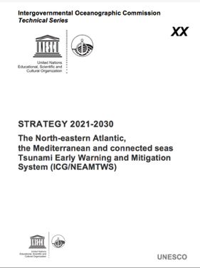
NEAMTWS
Chair and Vice Chairs
A. Amato, I. Aguirre Ayerbe, Amr Hamouda
Technical Secretary
D. Chang Seng
WG1 - Hazard assessment and modelling
(J. Macias / A. Gailler)
WG2 - Seismic, Geophysical and Sea Level Measurements
(A. von Gyldenfeldt / D. Cambaz)
WG3 - Public Awareness, Preparedness and Mitigation
(C. Valbonesi / R. Partheniu)
Task Team on Tsunami Exercises
C. Ozer Sozdinler /
M. Charalampakis
Task Team on Operations
A. Piatanesi /
F. Carrilho
Task Team on Documentation
N. Kalligeris /
S. Lorito
Task Team on Tsunami Ready
E. Daskalaki /
M.A. Baptista
New Task Team
Non seismic tsunami sources
F. Romano / R. Omira
New Task Team
Governance
I. A. Ayerbe/ D. Cambaz

Slide 4
Working Group on Tsunamis and Other Hazards Related to Sea-Level Warning and Mitigation Systems (TOWS-WG)
Task Team on Disaster Management and Preparedness
Ignacio Aguirre Ayerbe (Instituto de Hidráulica Ambiental de Cantabria, Spain)
Marinos Charalampakis (National Observatory of Athens, Greece)
Task Team on Tsunami Watch Operations
Hélène Hébert (Commissariat à l’Energie Atomique et aux Energies Alternatives, France)
Alessio Piatanesi ((Istituto Nazionale di Geofisica e Vulcanologia Roma, Italy)
Ocean Decade Tsunami Programme SC
Maria Ana Baptista (Instituto Superior de Engenharia de Lisboa, Instituto Politécnico de Lisboa, Portugal)
Technical Secretary: Denis Chang Seng

Slide 5
NEAMTWS MEETINGS 2024-25
13 May 2024: ICG/NEAM Steering Committee (online)
11 April 2024: Coastal Cities and Communities Joining Tsunami Ready, Ocean Conference, Barcelona
24-25 May 2024 CoastWAVE Project- Phase 1 Closure Meeting, Alexandria, Egypt
Coastal Horizons: … Strengthen Resilience to Coastal Hazards, 57 IOC Exec. Council, June 202 – Side Event
Nov. 2024: Global Symposium, Banda Aceh, Indonesia
26 Nov. 2024: ICG/NEAM Steering Committee
27-29 Nov. 2024: ICG/NEAMTWS XIX Session
2024: Several TSp meetings
2025: Santorini situation meetings (February)
2025: Lisbon TSP meeting on PTF application (March)
2025: Tsunami Source meeting (March)
2025: Istanbul NEAM Steering Committee (May)

Slide 6
Some D&R and news from the last NEAM ICG
Reaffirmed the target to have a total of 25 UNESCO-IOC Tsunami Ready Recognized communities in NEAM countries by the end of 2026…
Noted the official closure of Phase I of the European Union DG-ECHO CoastWAVE project on 30 June 2024 and the external evaluation carried out…
Also noted the official start of Phase II of the new CoastWAVE Project (CoastWAVE 2.0) ‘Scaling-Up and Strengthening the Resilience of Coastal Communities in the NEAM and its kick-off workshop on 6 November 2024;
Agreed to adopt the threat levels as requested by the Task Team on Tsunami Watch Operations…
Decided to establish the new Task Team on Governance and conduct the next NEAMWave exercise in March 2026 (NEAMWave26);
Projects Related to NEAMTWS (EU), EPOS, GeoInquire, GTM, NEAM-COMMITMENT: NEAM Collaboration fOr iMproved tsunaMi rIsk miTigation and manageMENT
Also appreciates the increase in number of actions submitted (Ocean Decade Call 7) in the NEAM region endorsed and submitted to Ocean Decade
Appreciates the newly recognized UNESCO-IOC Tsunami Ready Communities in Egypt (Alexandria), France (Cannes), Greece (Samos), Italy (Minturno), Spain (Chipiona) and Türkiye (Büyükçekmece) in 2024;

Slide 7
NEAMTWS Chair presentations/ participation
ICGs and TOWS meeting in Paris on February 2025
PTWS-ICG on April 9, 2025 (+ S. Lorito for PTF)
Caribe-ICG on May 6, 2025
Santorini meetings on February 2025
RTRB meetings (Israel application)

Slide 8
Some topics highlighted by NEAM ICG
First NEAM recognized TR communities (6 in 6 Member States) and more coming
Imminent (?) adoption of threat levels
Imminent (?) PTF implementation
New OUG ongoing
New TT on non-seismic tsunamis and on Governance
Intense activities for SMART cables, offshore observatories, etc.
Many activities for raising awareness on tsunami risk
Testing new methods for hazard zones mapping (e.g. Larnaca, Nat’l scale…)
Many new projects (CW2.0, NEAM-C, EPOS-ON, etc.)
Recent events (incl. April 23, Marmara Sea alert - thanks Didem)

Slide 9
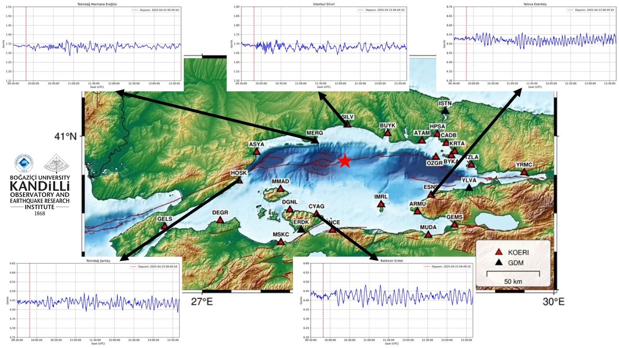

Sea level measurements in the Marmara Sea region for April 23, Mw6.3 earthquale and tsunami alert (Advisory):
Good test for the new Turkish tide gauge network
(Thanks Didem!)
COUNTRY GAUGE LOCATION LAT LON TIME AMPLITUDE(M) PERIOD(MIN)
------------- ---------------- ------- ------- ------------ ------------ -----------
TURKIYE ISTANBUL SILIVRI 41.0724 28.2390 0950Z 23 APR 00.03 02.1
TURKIYE TEKIRDAG M.EREGLI 40.9690 27.9622 0954Z 23 APR 00.02 06.4
TURKIYE YALOVA ESENKOY 40.6183 28.9532 1003Z 23 APR 00.04 04.8
TURKIYE BALIKESIR ERDEK 40.4924 27.9761 1006Z 23 APR 00.06 06.4
TURKIYE TEKIRDAG SARKOY 40.7098 27.3143 1010Z 23 APR 00.05 06.4

Slide 10
TSUNAMI MESSAGE NUMBER 001
NEAM INGV IT-NTWC TSUNAMI SERVICE PROVIDER
ISSUED AT 2256Z 13 MAY 2025
ORIGIN TIME - 2251Z 13 MAY 2025
COORDINATES - 34.96 NORTH 26.94 EAST
DEPTH - 100 KM
LOCATION - CRETE_GREECE
MAGNITUDE - 5.9
Earthquake and Information messages by the 3 TSP
MAY 13 2025 at 22:51 UTC
Very good timing
Very high coherence
TSUNAMI MESSAGE NUMBER 001
NEAM TSUNAMI SERVICE PROVIDER KOERI (TURKIYE)
ISSUED AT 2257Z 13 MAY 2025 (*)
ORIGIN TIME - 2251Z 13 MAY 2025
COORDINATES - 34.92 NORTH 26.96 EAST
DEPTH - 76.00 KM
LOCATION - CRETE, GREECE
MAGNITUDE - 5.8 [MWP]
(*) arrived at INGV at 22:58
∩╗┐TSUNAMI MESSAGE NUMBER 001
NEAM NOA HL-NTWC TSUNAMI SERVICE PROVIDER
ISSUED AT 2256Z 13 MAY 2025 (*)
ORIGIN TIME - 2251 UTC TUE MAY 13 2025
COORDINATES - 34.97 NORTH 27.05 EAST
DEPTH - 82.0 KM
LOCATION - EASTERN MEDITERRANEAN SEA
MAGNITUDE - 5.9 M
(*) arrived at INGV at 23:00

Slide 11
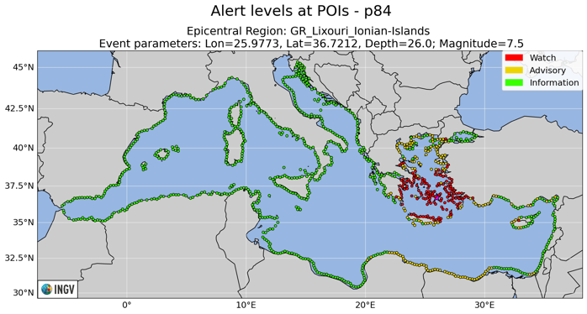
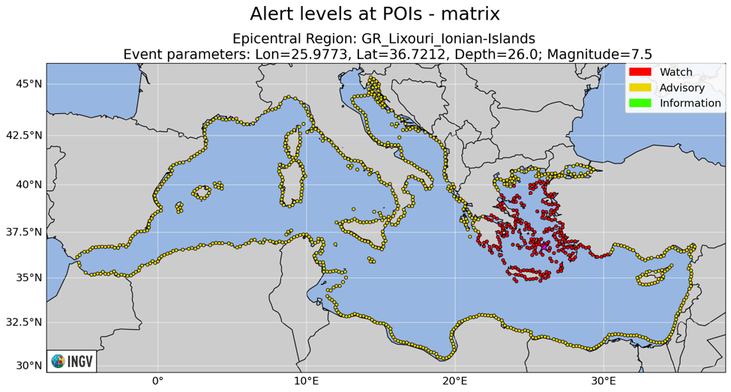
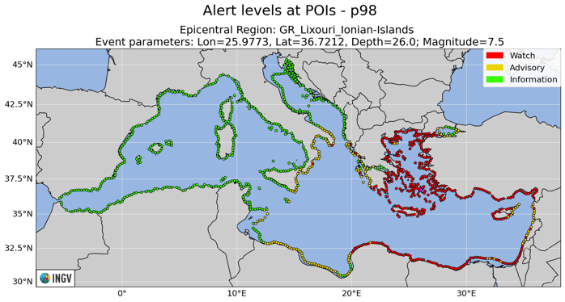
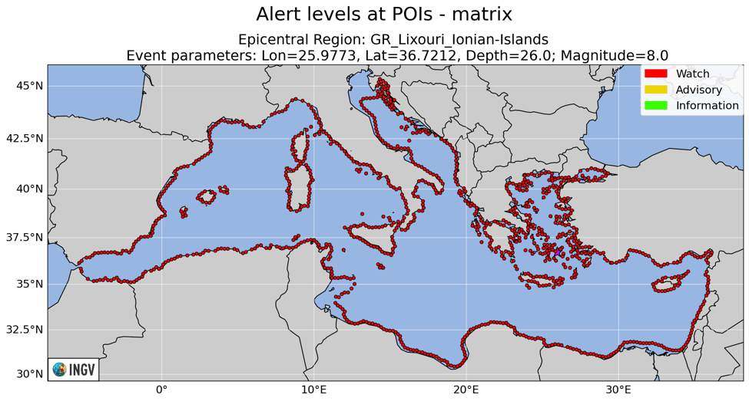
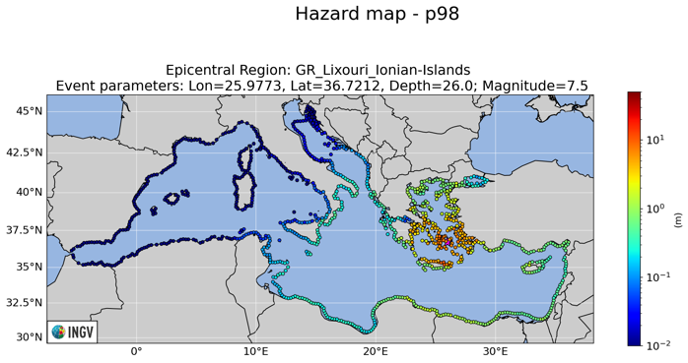
TESTING PROBABILISTIC TSUNAMI FORECAST - SANTORINI

Slide 12
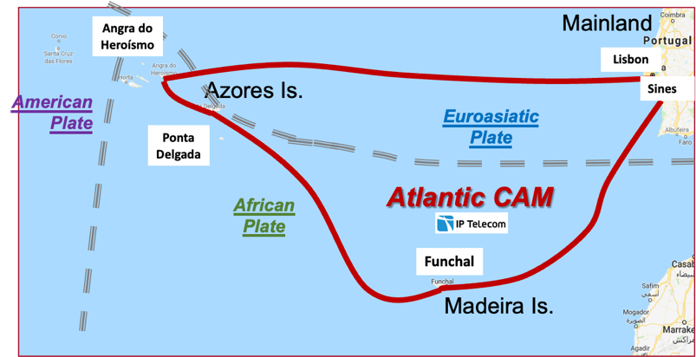
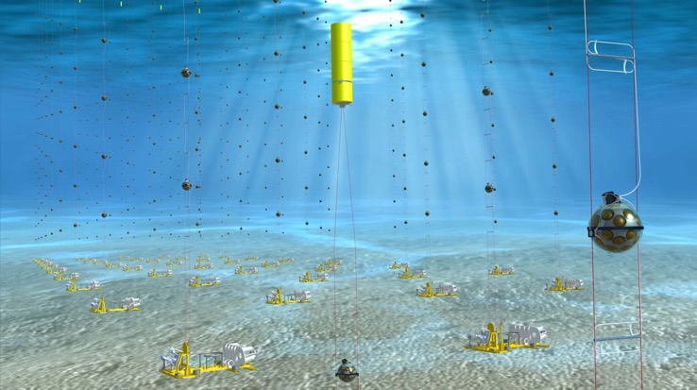
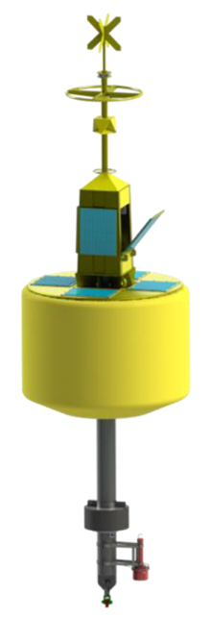
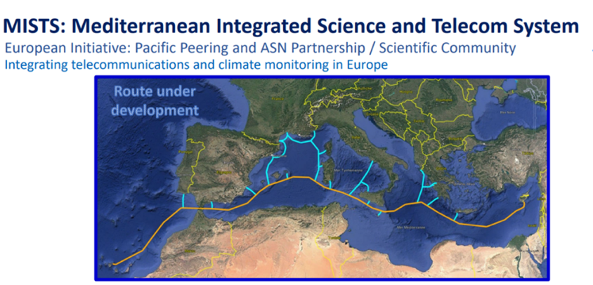
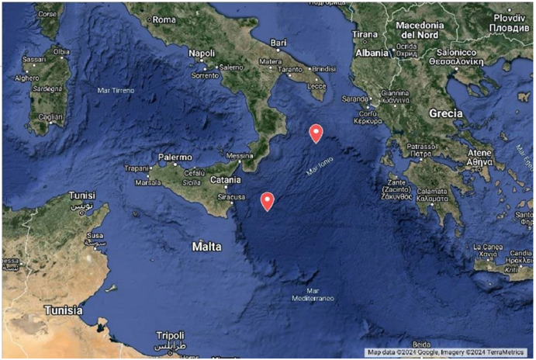
ONGOING ACTIVITIES: SMART CABLES, TSUNAMI BUOYS, OBSERVATORIES

Slide 13
Some points for future discussions
Discussion with ICG – Caribe for managing events in the Atlantic Sea
Problems wth EMSC (and Google?) for emergency communication during tsunami alerts (see next slide)
Regional Tsunami Ready Board composition and roles
Projects harmonization (and dissemination)
Collection of NEAM papers (https://drive.google.com/drive/u/0/folders/1WNFMOFAN3PiEmDZ_h0MYpQh8Nj7QVpv- )
ICG-2025 ;-(

Slide 14
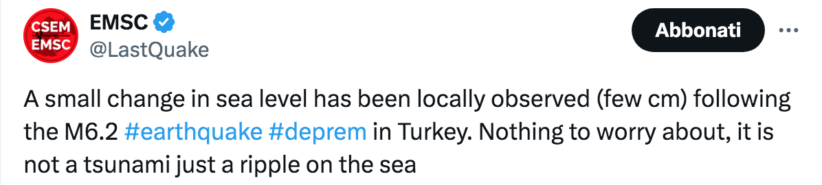
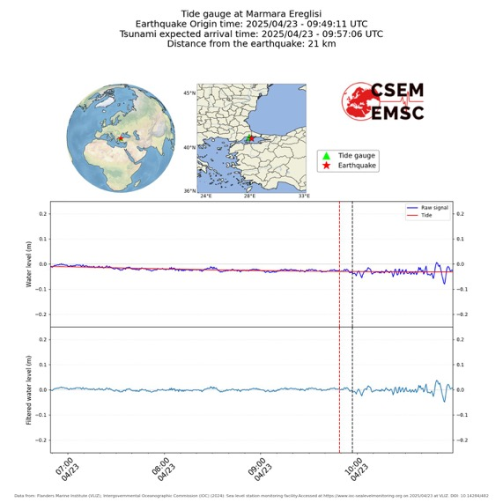
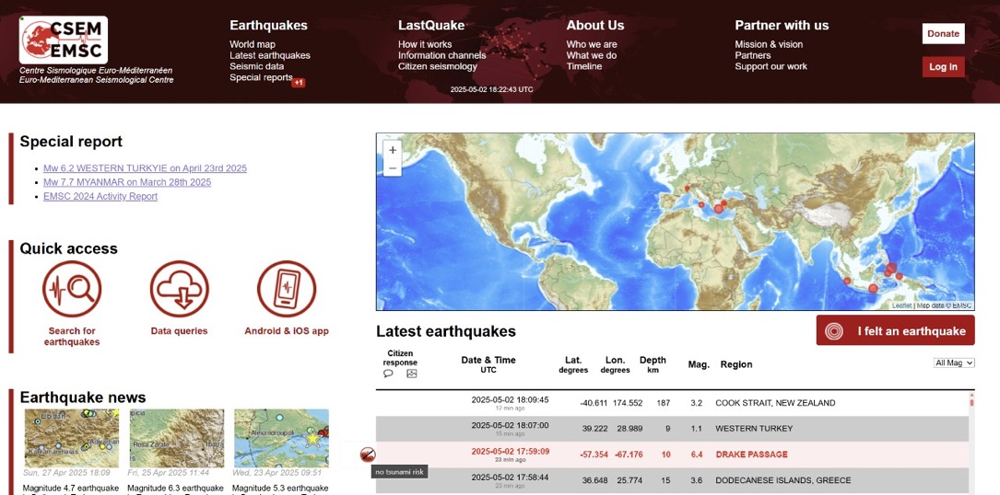

1:17 PM · 23 apr 2025 72.505 views
https://x.com/LastQuake/status/1915002124791959716
https://x.com/LastQuake/status/1918291903436501320

Slide 15
THANK YOU

