Slide 1
NEAMTWS Steering Committee meeting, Istanbul, Türkiye, 15-16 May 2025
The NEAM-COMMITMENT EU project
aiming to support Improved tsunami risk management and planning in the NEAM region
Marinos Charalampakis, Nikos Kalligeris, Laura Graziani, Ignacio Aguirre Ayerbe, Pio Di Manna, Vitor Silva, Jorge Macias, Domenico Russo, Costas E. Synolakis, Andreas Antonakos, Sylvana Pilidou, Luigi D'Angelo, Carlos González González, and the NEAM-COMMITMENT project team
Institute of Geodynamics, National Observatory of Athens
Hellenic National Tsunami Warning Center

Slide 2
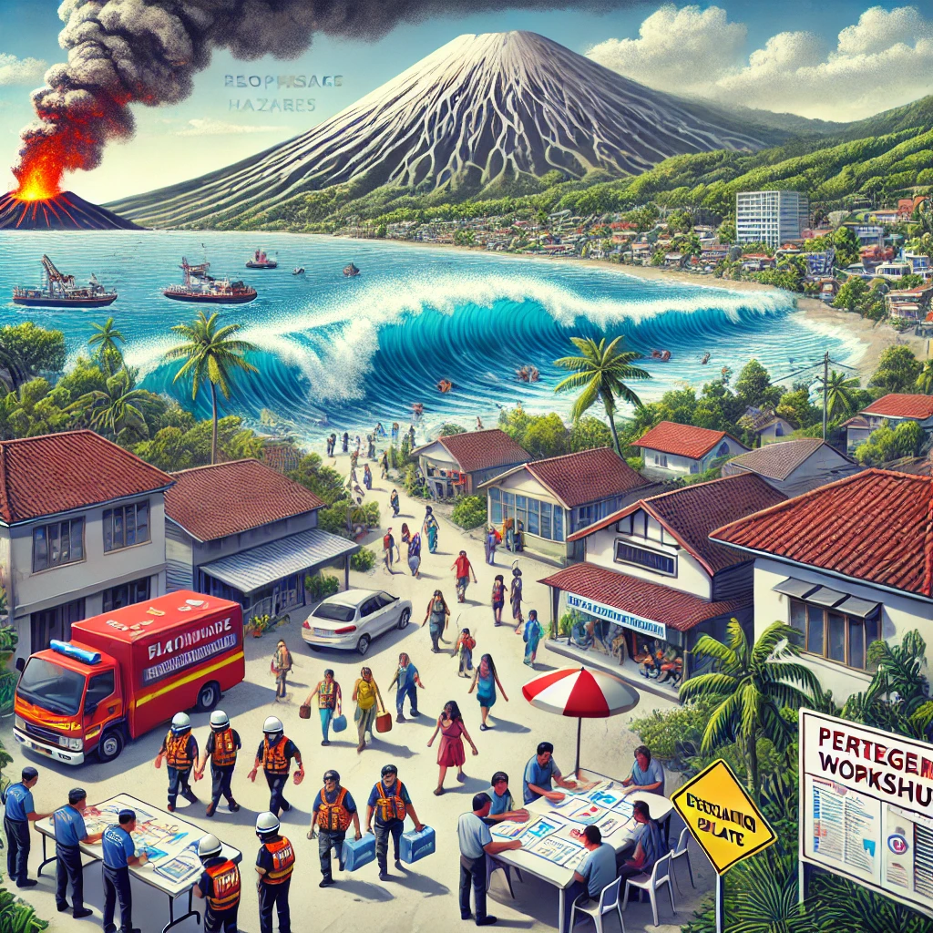
Aim - Rationale
Aim: Improve tsunami preparedness in the NEAM region, at different scales, for effective risk, evacuation and emergency management.
Objectives are spanning from the national to local levels, addressing needs for national tsunami risk planning and for enhancing multi-hazard preparedness in coastal communities at risk.
National level:
National-level tsunami inundation maps are crucial for coastal planning and risk management.
Support local tsunami hazard assessment and evacuation planning.
Contribute to important global tsunami initiatives like IOC/UNESCO’s Tsunami Ready Recognition Programme (TRRP) and Ocean Decade Tsunami Programme (ODTP) by scaling hazard assessment nationally.
Local level:
Tsunamis from earthquakes and volcanic activity pose significant risks for coastal communities in the NEAM region.
A multi-hazard approach considering cascading effects is needed for effective tsunami evacuation and emergency management.
Emphasis on science-informed participatory workshops and decision-making to improve local planning and implementation effectiveness.

Slide 3
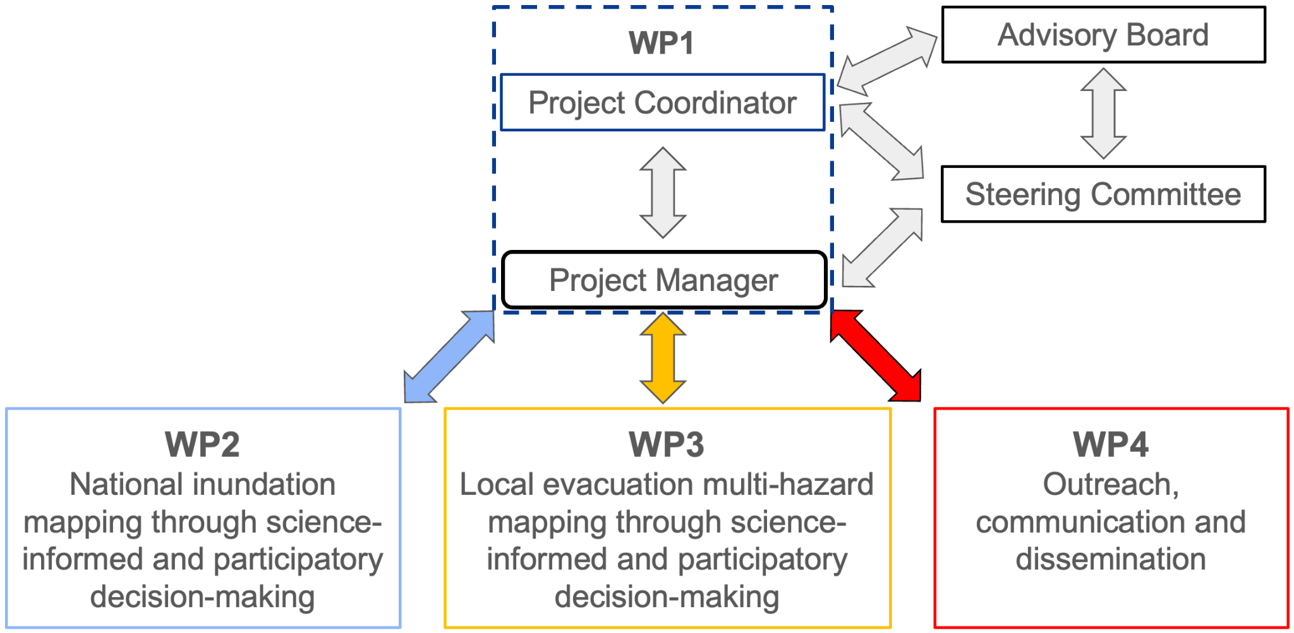
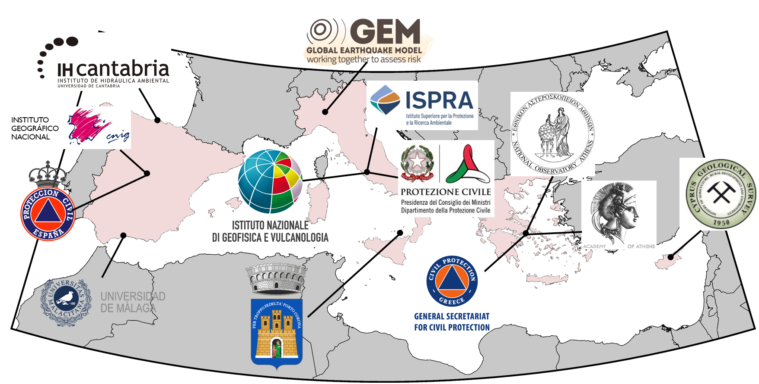
The Consortium
Project management's organizational structure
No | INSTITUTE | Sort Name
1 | National Observatory of Athens, Greece - COO | NOA
2 | Istituto Nazionale di Geofisica e Vulcanologia, Italy | INGV
3 | Cantabria Environmental Hydraulics Institute Foundation, Spain | FIHAC
4 | Institute for Environmental Protection and Research, Italy | ISPRA
5 | Global Earthquake Model Foundation. Italy | GEM
6 | University of Malaga. Spain | UMA
7 | Municipality of Lipari, Italy | MoL
8 | Academy of Athens. Greece | AoA
9 | General Secretariat of Civil Protection, Greece | GSCP
10 | Geological Survey Department, Cyprus | GSD
11 | Civil Protection Department, Italy | DPC
12 | Directorate General of Civil Protection and Emergency | DGPCE
13 | National Geographic Institute | IGN
NOA
INGV
IHC
NOA
13 partners from 4 counties: Cyprus, Greece, Italy and Spain
3 national CPAs (GR, IT, ES)
1 municipality (Lipari)
1 international organization (GEM)
4 National Tsunami Warning Centers (GR, IT, CY, ES)

Slide 4
Expected project outputs
National level
Development of national tsunami Inundation maps (CY, GR, ES)
Dissemination of results across relevant national stakeholders
Development of guidelines and tools for implementation in other countries/regions
Dissemination of methodological approach at international level

Slide 5
Expected project outputs
Local level
Science-informed and participatory decision-making for tsunami evacuation planning and management, considering multi-hazard effects
Application @ two pilot sites in Greece and Italy
Development of guidelines
Awareness raising activities

Slide 6
Call: UCPM-2024-KAPP
Type of Action: UCPM-PJC
Title: NEAM Collaboration fOr iMproved tsunaMi rIsk miTigation and manageMENT
Acronym: NEAM-COMMITMENT
Number: 101193486
Duration: 24 months (31 January 2027)
Start Date: 01 February 2025
Estimated Project Cost: €985 629.70
Requested EU Contribution: €887 066.62
Project Officer: Juan Francisco GALVAN MONTERO
Budget categories/activity types:
- A. Personnel costs
A.1 Employees
- B. Subcontracting costs
- C. Purchase costs
C.1 Travel and subsistence
C.3 Other goods, works and services
- E. Indirect costs (flat-rate: 7% of the eligible direct costs)
- VAT: No

Slide 7
Project News/Upcoming Activities
Project news
The project kick-off meeting was held in Athens on 24-25 March, 2025;
The project identity plan, including the logo, has been completed;
Application for UN Ocean Decade Action endorsement ;
Expression of interest and contact with Lebanon to participate in project activities related to development of national tsunami inundation maps.
Upcoming project activities
Training workshop on development of national tsunami inundation maps, hosted by ISPRA in Rome – May 2025;
Drafting of project communication and dissemination plan, which will include dissemination activities with the NEAMTWS and other ICG’s to share project outcomes, including tools and guidelines developed through the project.

Slide 8
Thank you

